Slide 1


Ocean and Carbon Literacy for Coastal Communities
How climate change is affecting our seas and what we can do about it.

Slide 2
Part one
Climate Change
Notes:
Introduction to Climate Change, and how it impacts our world. We are going to look at what climate change is, what causes it, what are the consequences and what we can do about it.

Slide 3
Weather or Climate?
Notes:
Ask the children what they think the difference is between weather and climate before moving on to the next slide.

Slide 4


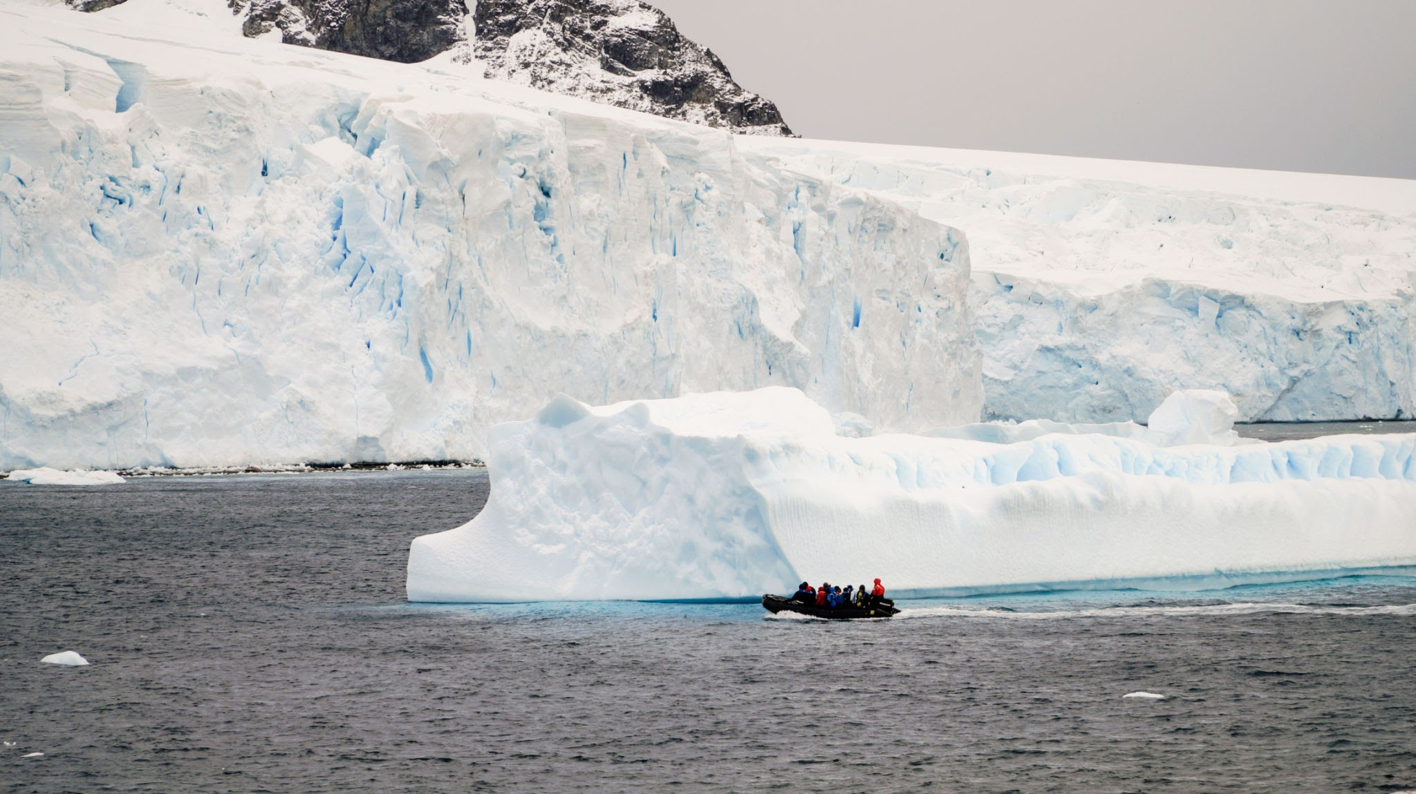
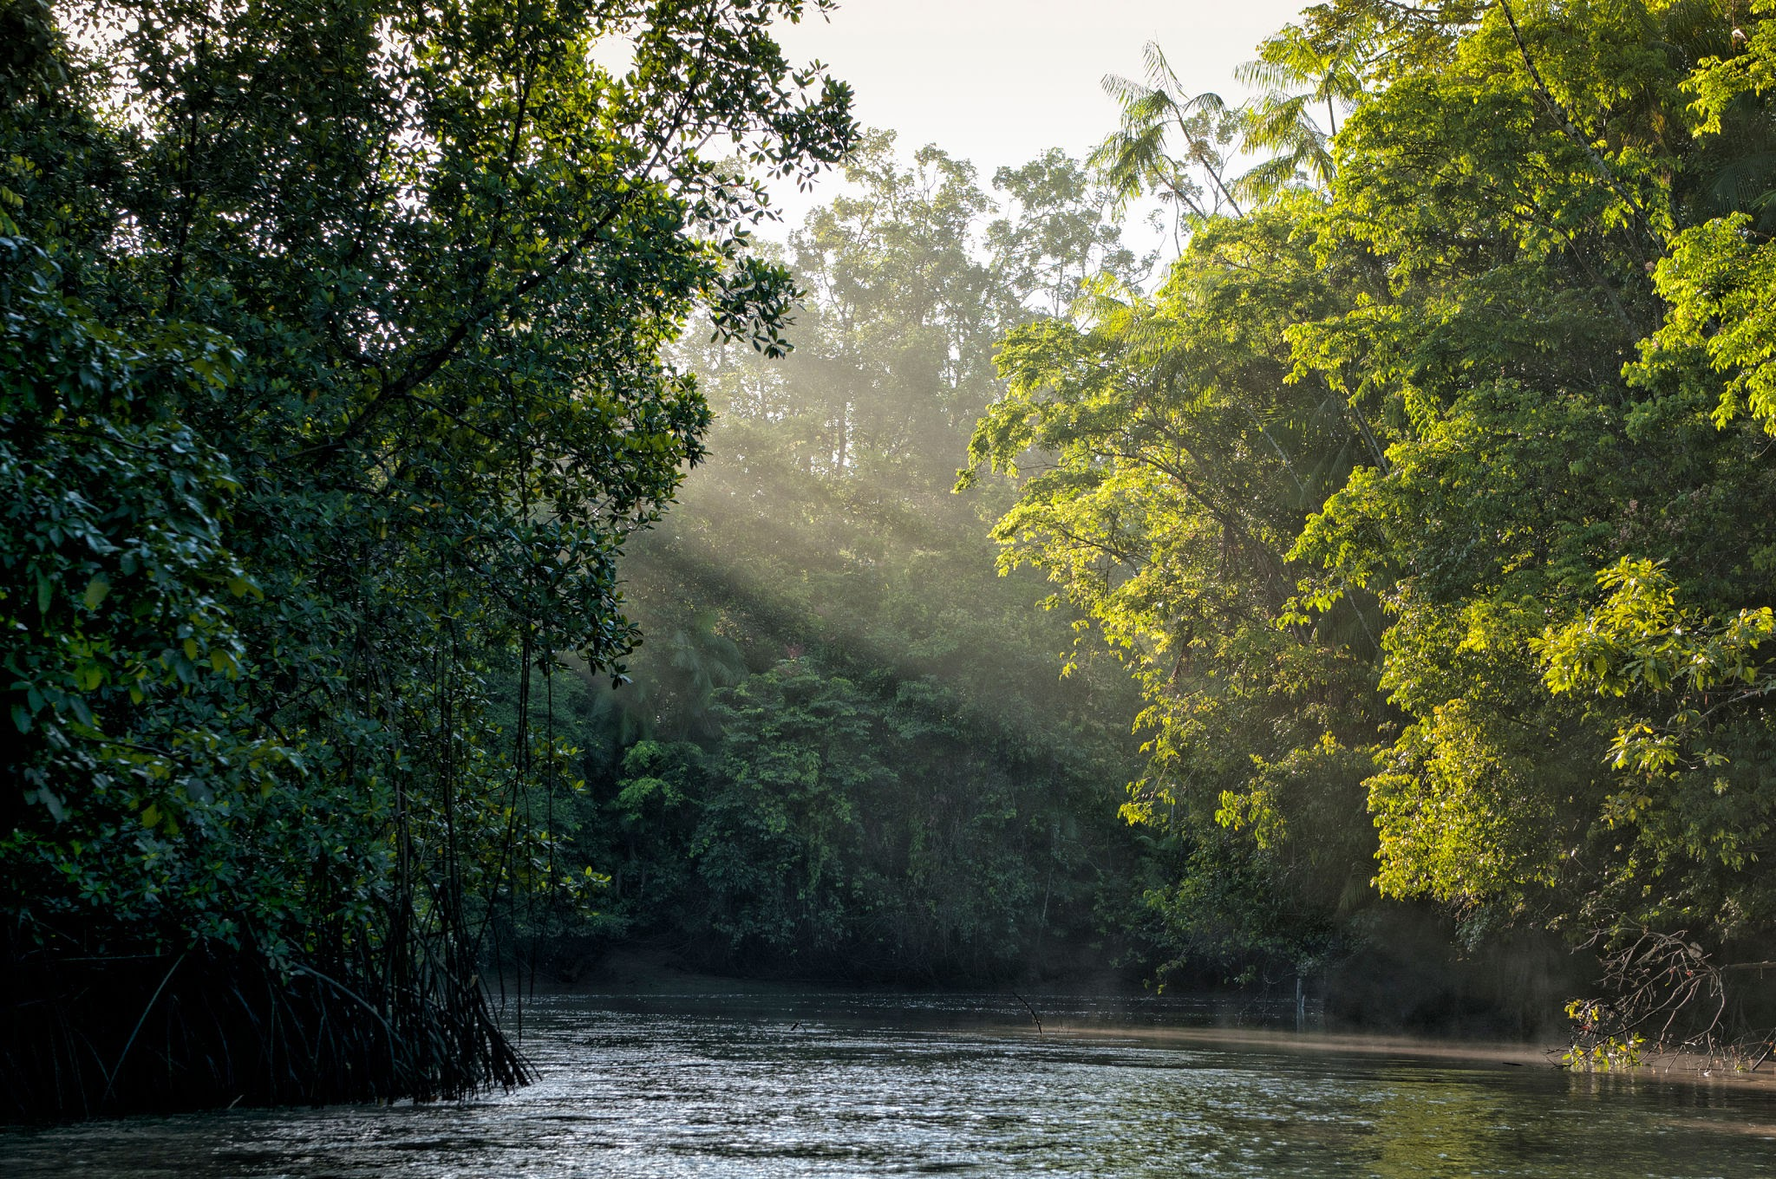

Weather or Climate?
Weather is day to day and seasonal changes. This could be
a rainy day, a sunny day, snow, thunder storm, or strong wind
Climate is longer term changes Climate varies between different regions of the world. For example, Antarctica and the Amazon have different climates.
Notes:
Weather is short term changes to the lower atmosphere. It could be rain, temperature, wind speed or direction, humidity or atmospheric pressure.
Climate is atmospheric changes over longer periods of time, usually defined as 30 years or more. Climate can be thought of as an average of weather over time.
Use this slide to further cement the idea of weather - what is the weather like today? - and climate - what is the climate in Scotland? What is the climate in the Arctic / Australia?

Slide 5
What is Climate Change?
Notes:
Elicit some ideas from the students as to what they think Climate change is. Move on to next slide when answers lean towards idea of increased temperatures and global warming.

Slide 6
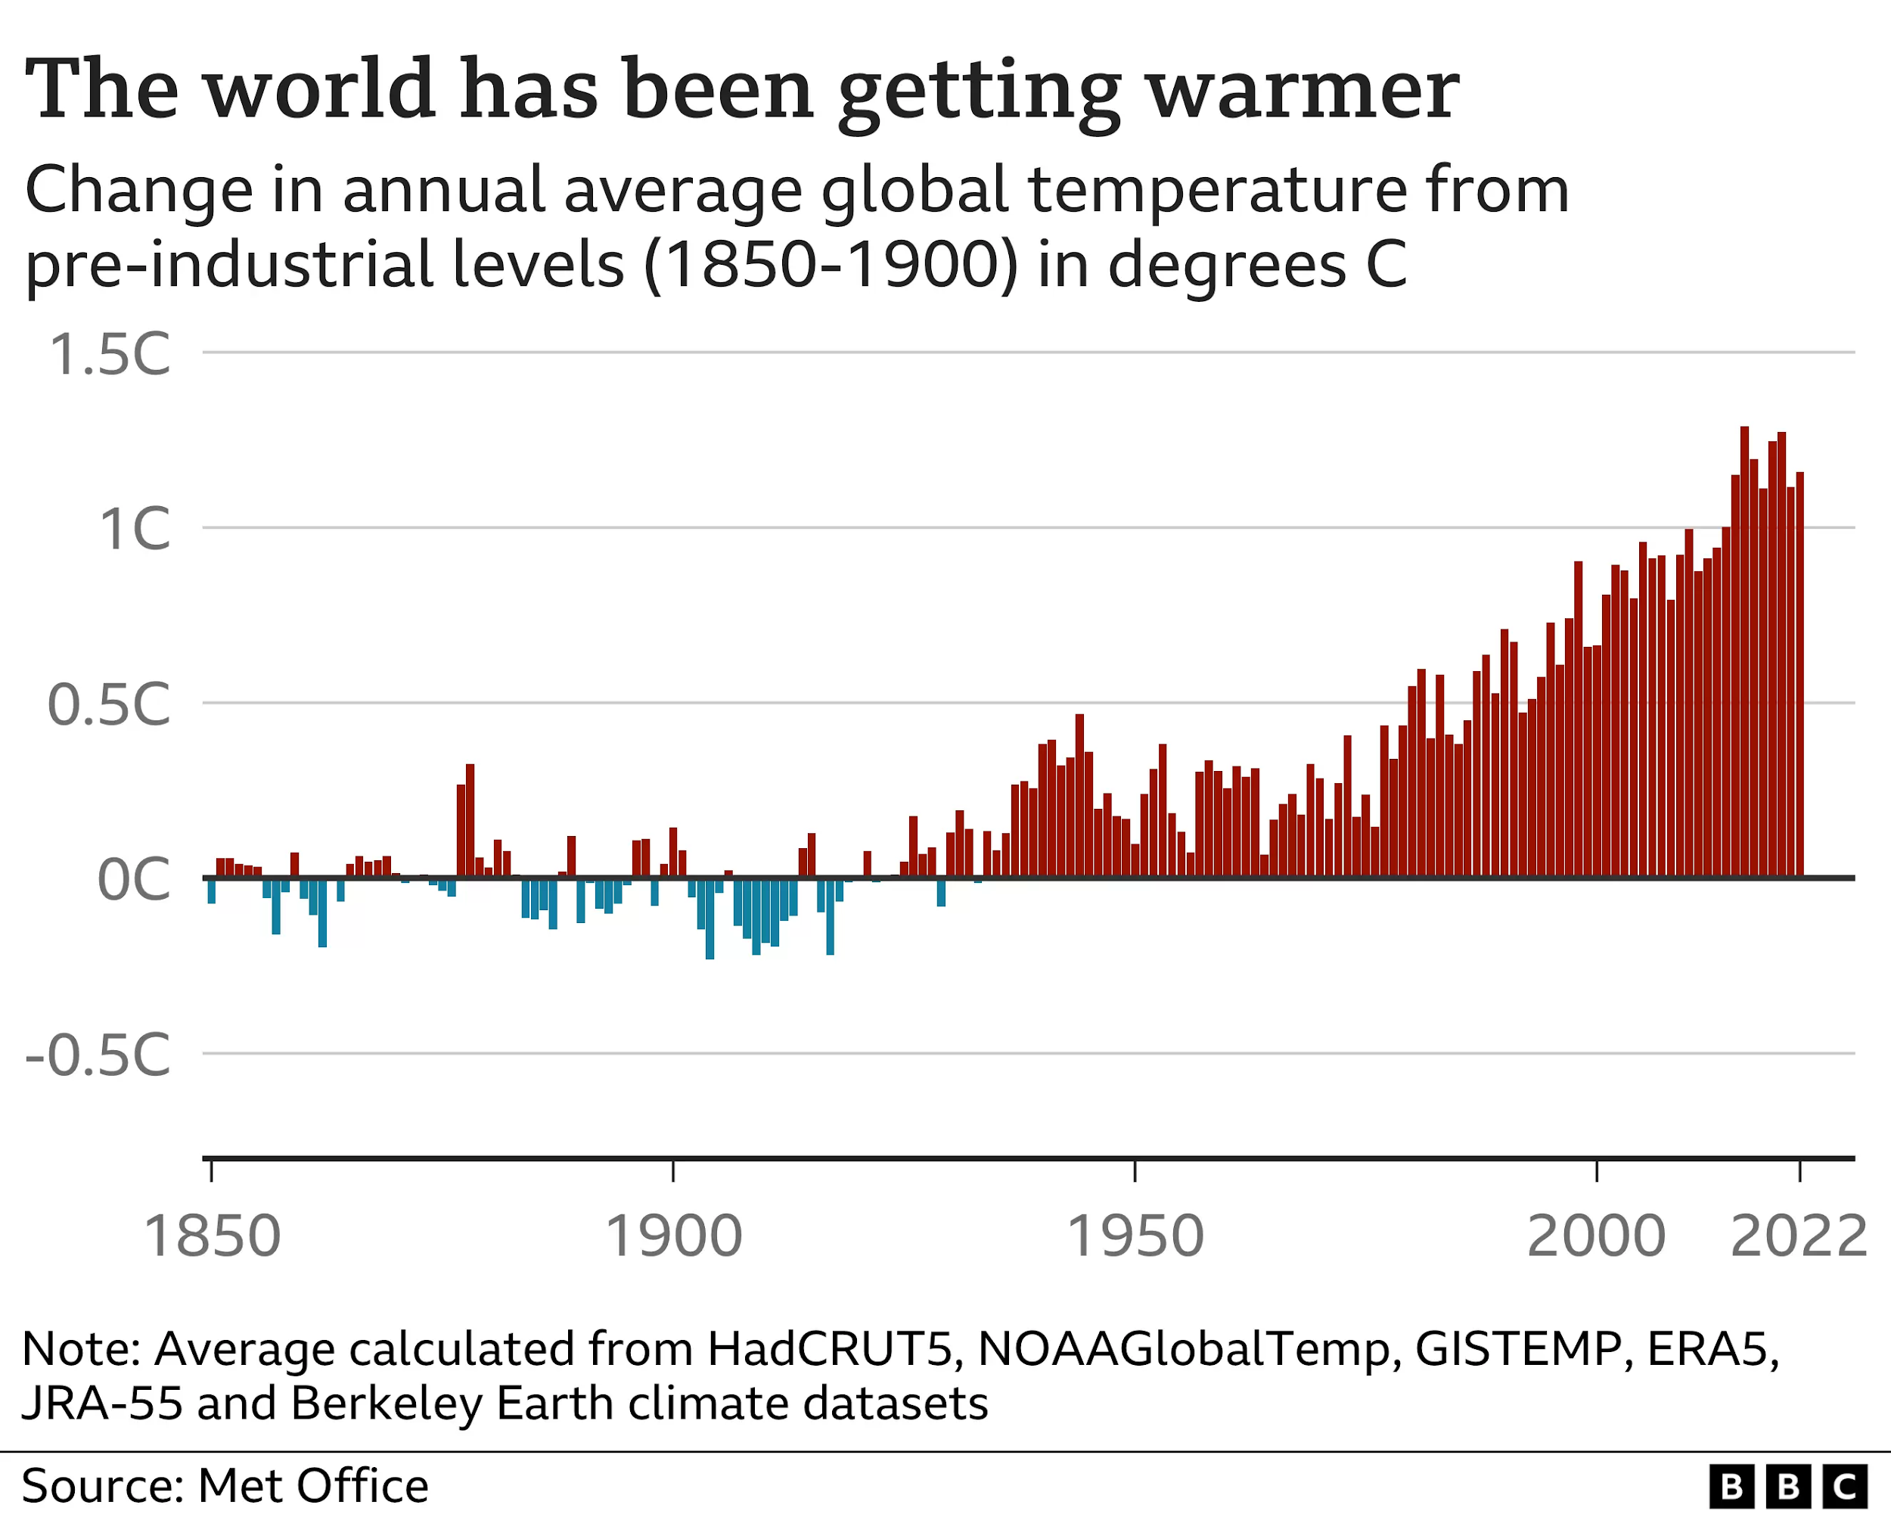
Global temperatures are rising as a result of human activity.
Notes:
Climate change is a shift in the average weather conditions over a period of time. The climate has changed naturally over the course of Earth’s history, but scientists are sure that there is no doubt that the rapid change in climate that has occurred in the last century is a result human actions.
Highlight warming trend using graph. Look at dates - what happened here, why has shift occurred at this time? (pre-industrial to industrial society)

Slide 7
What is causing Climate Change?
Notes:
Elicit ideas from group before moving on to next slide

Slide 8
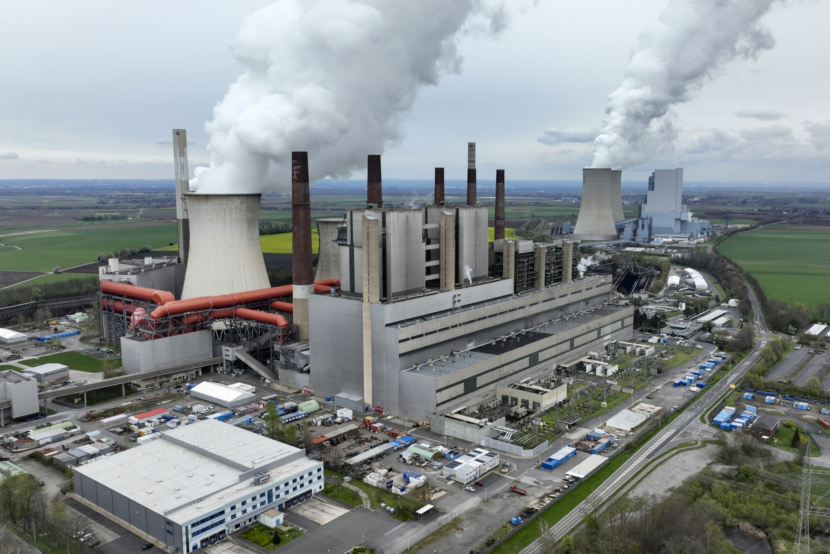
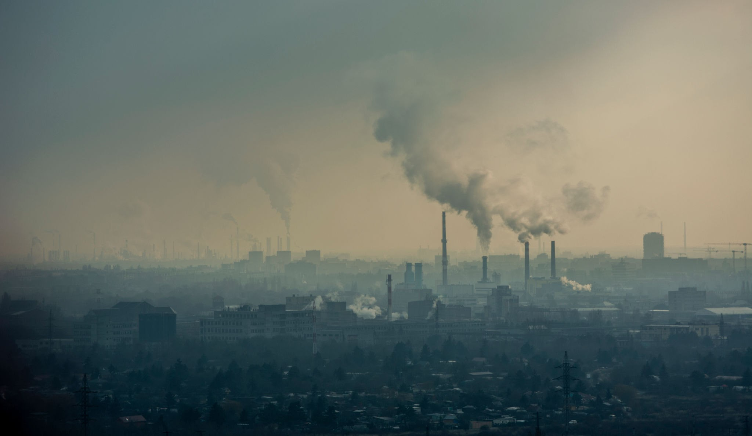
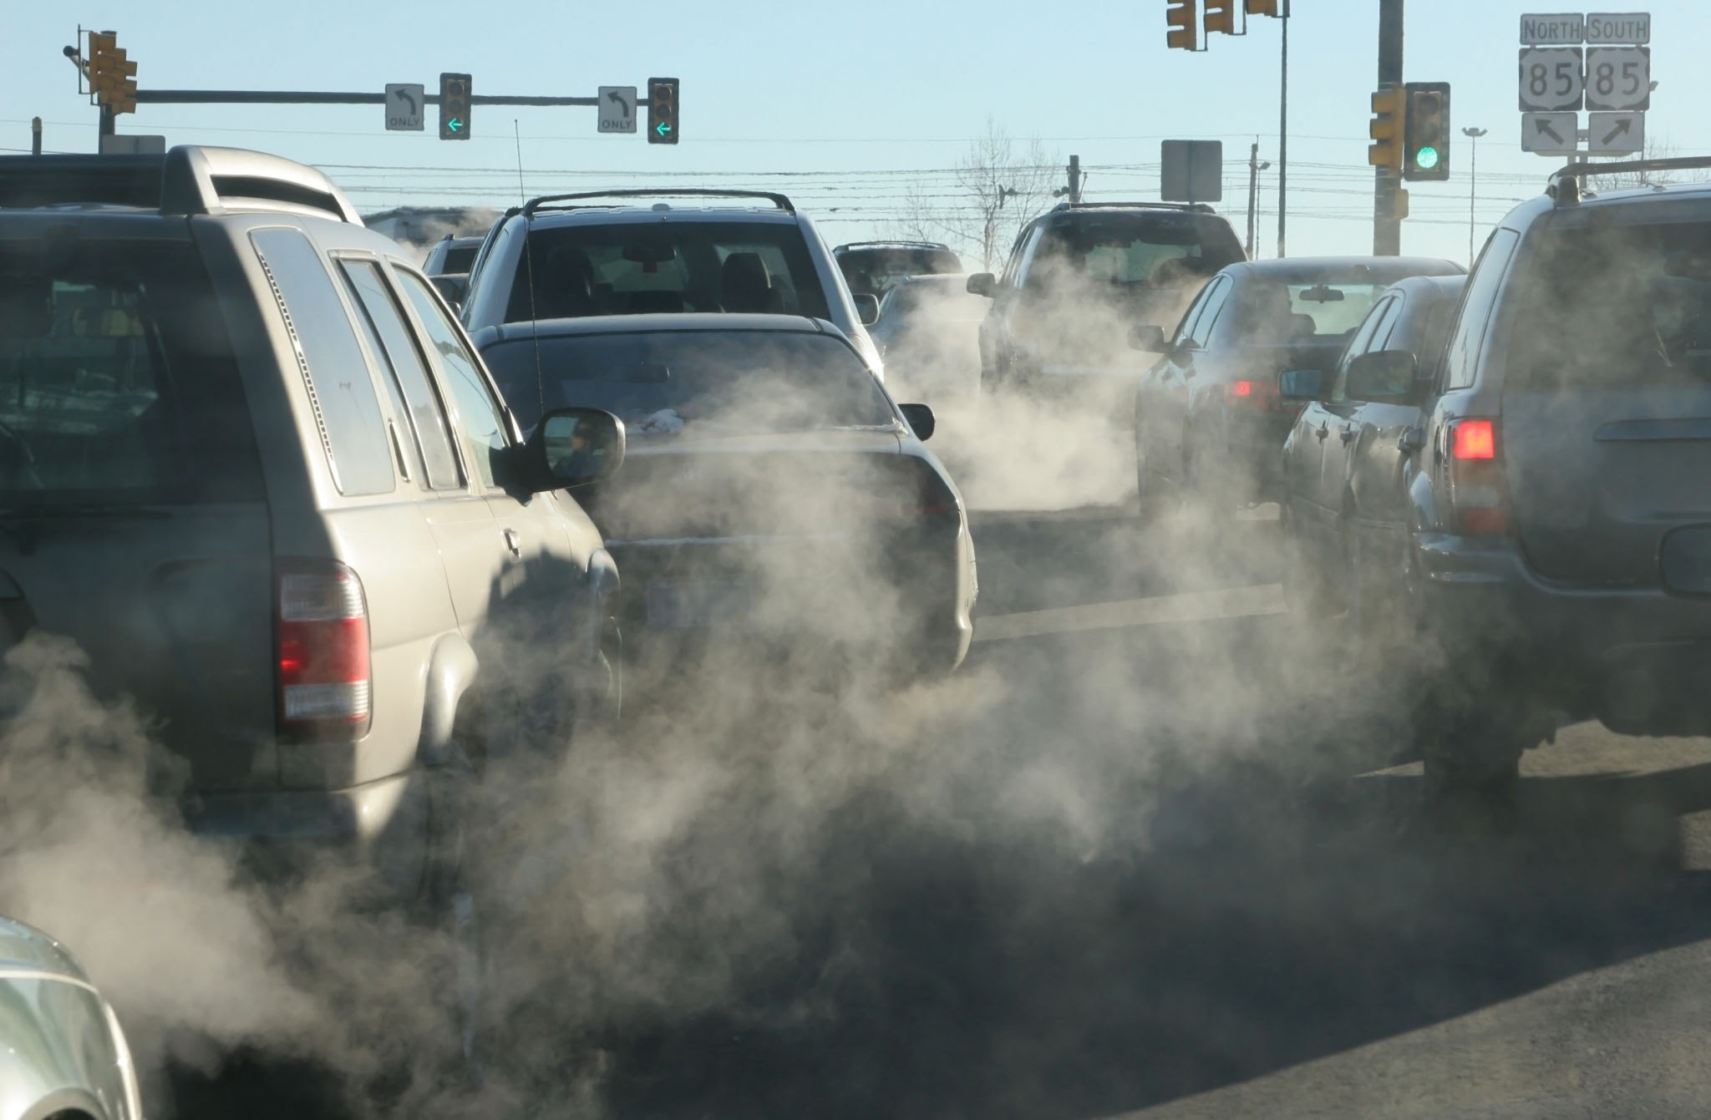
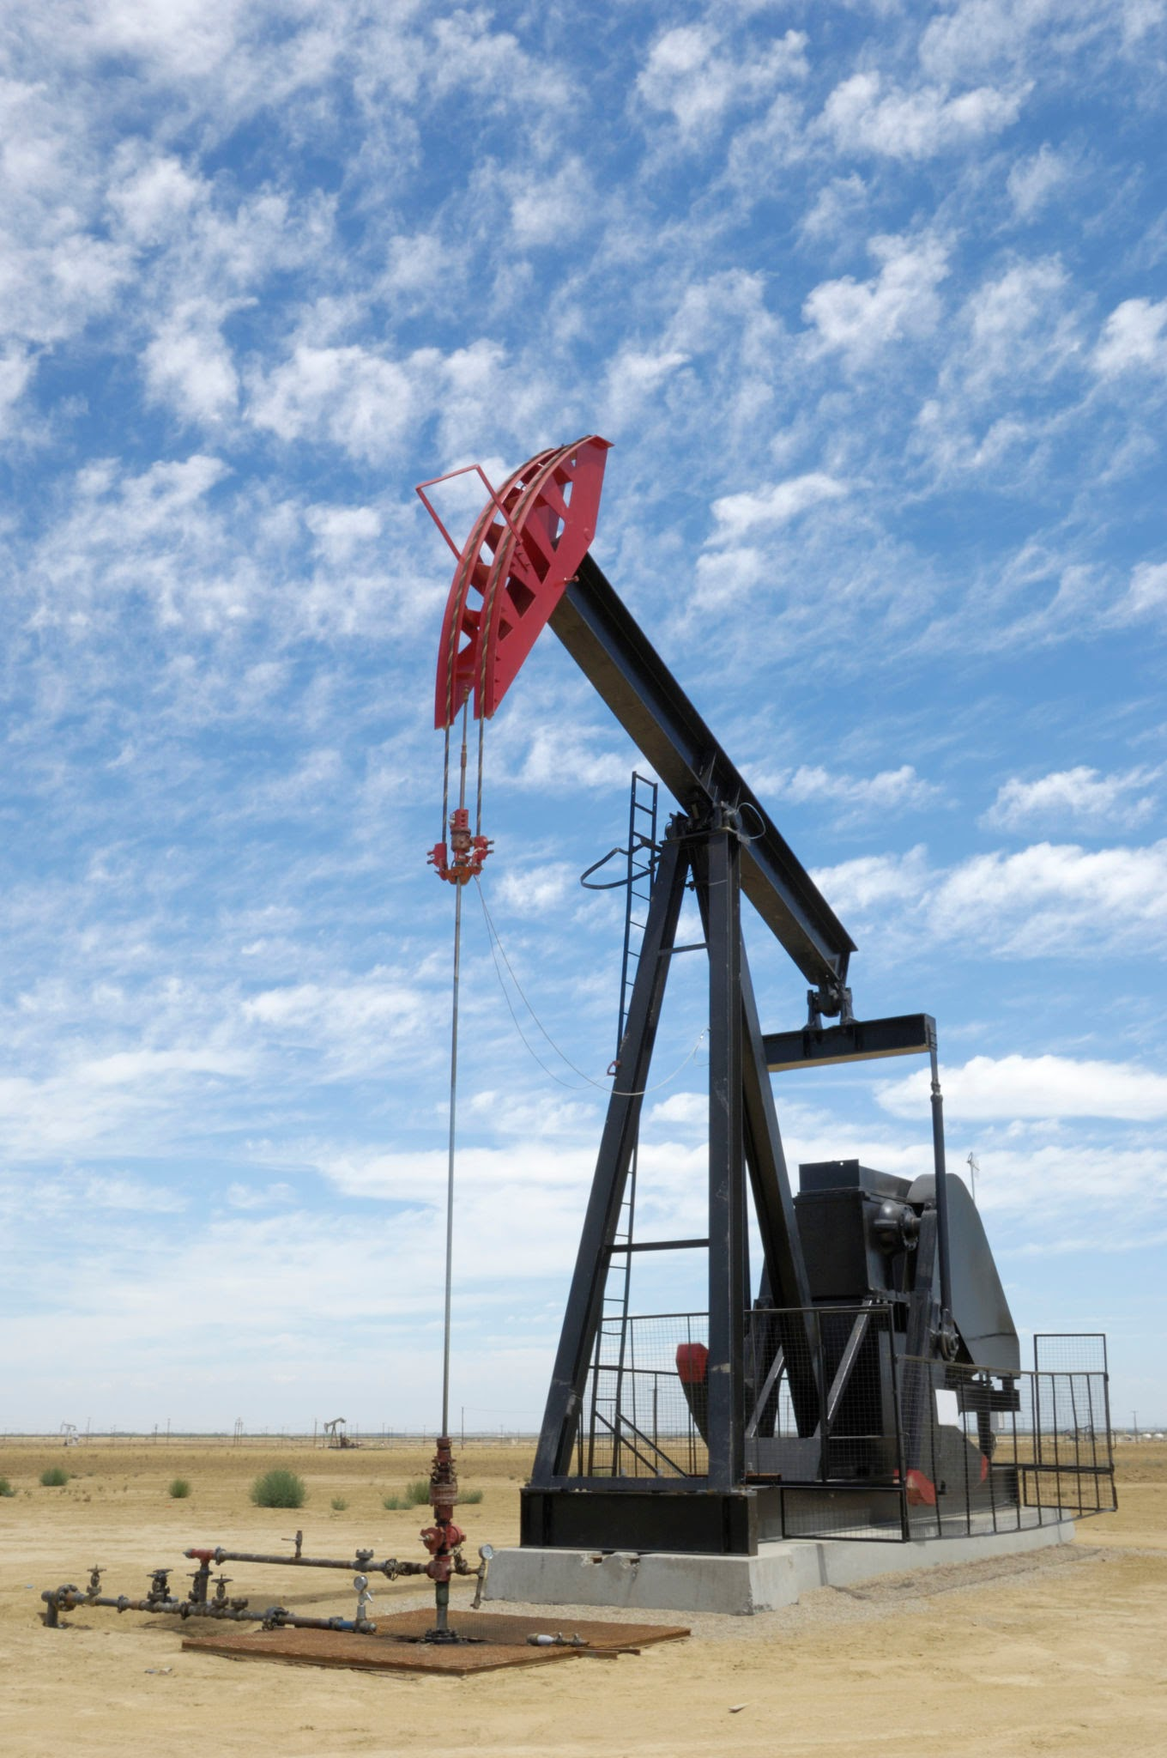
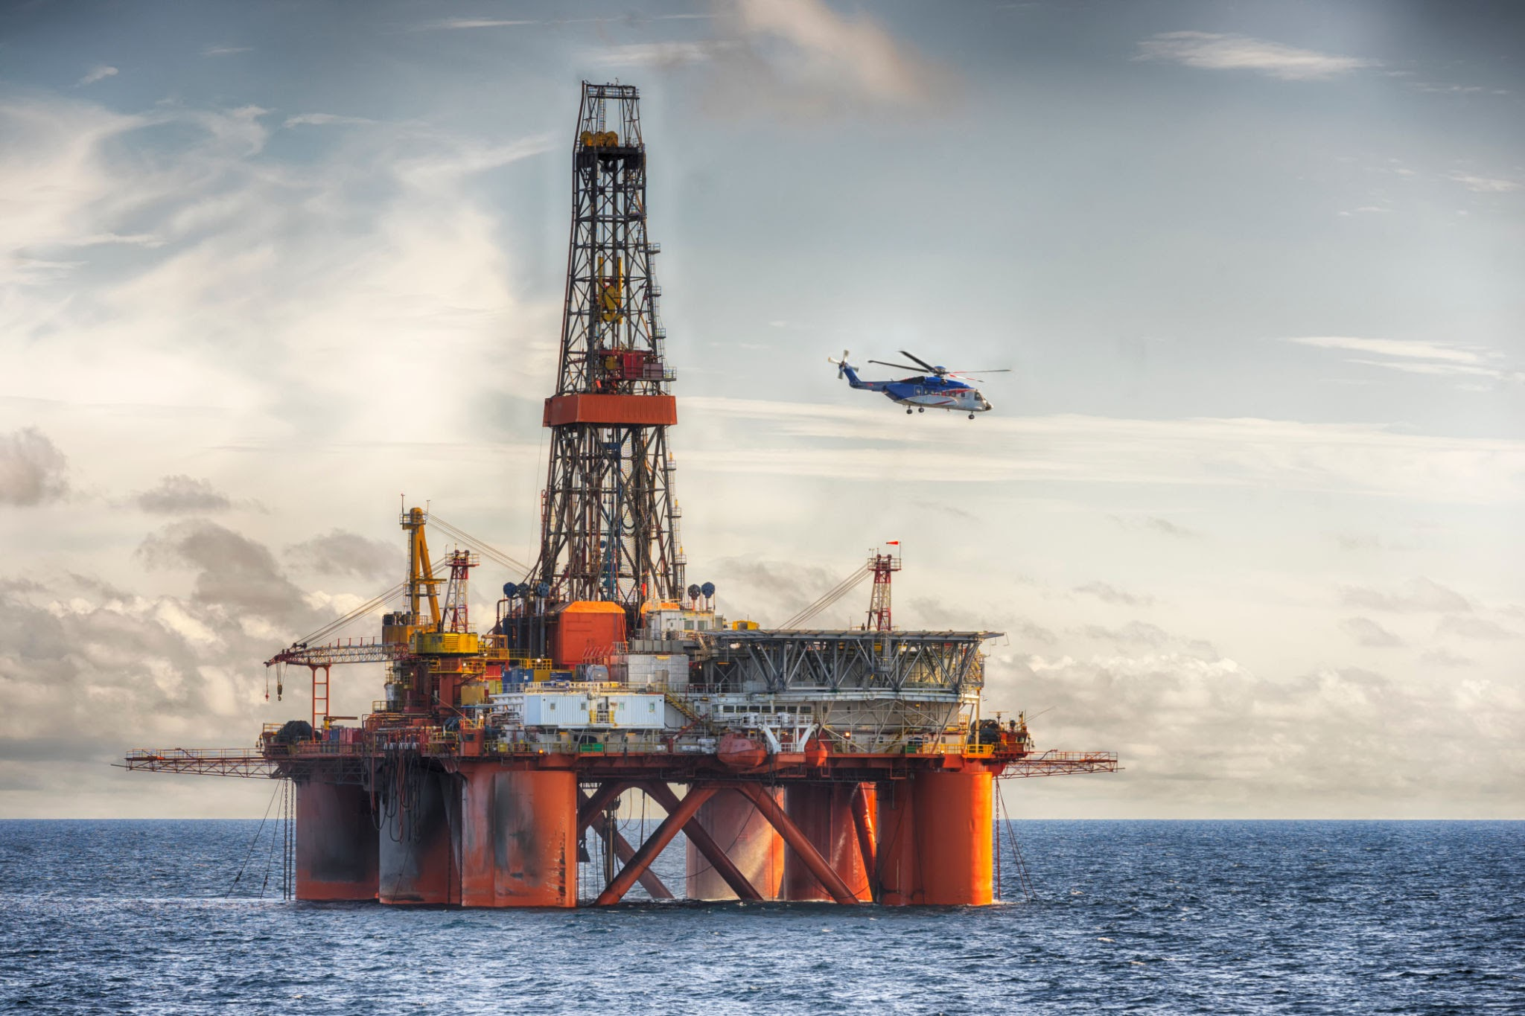
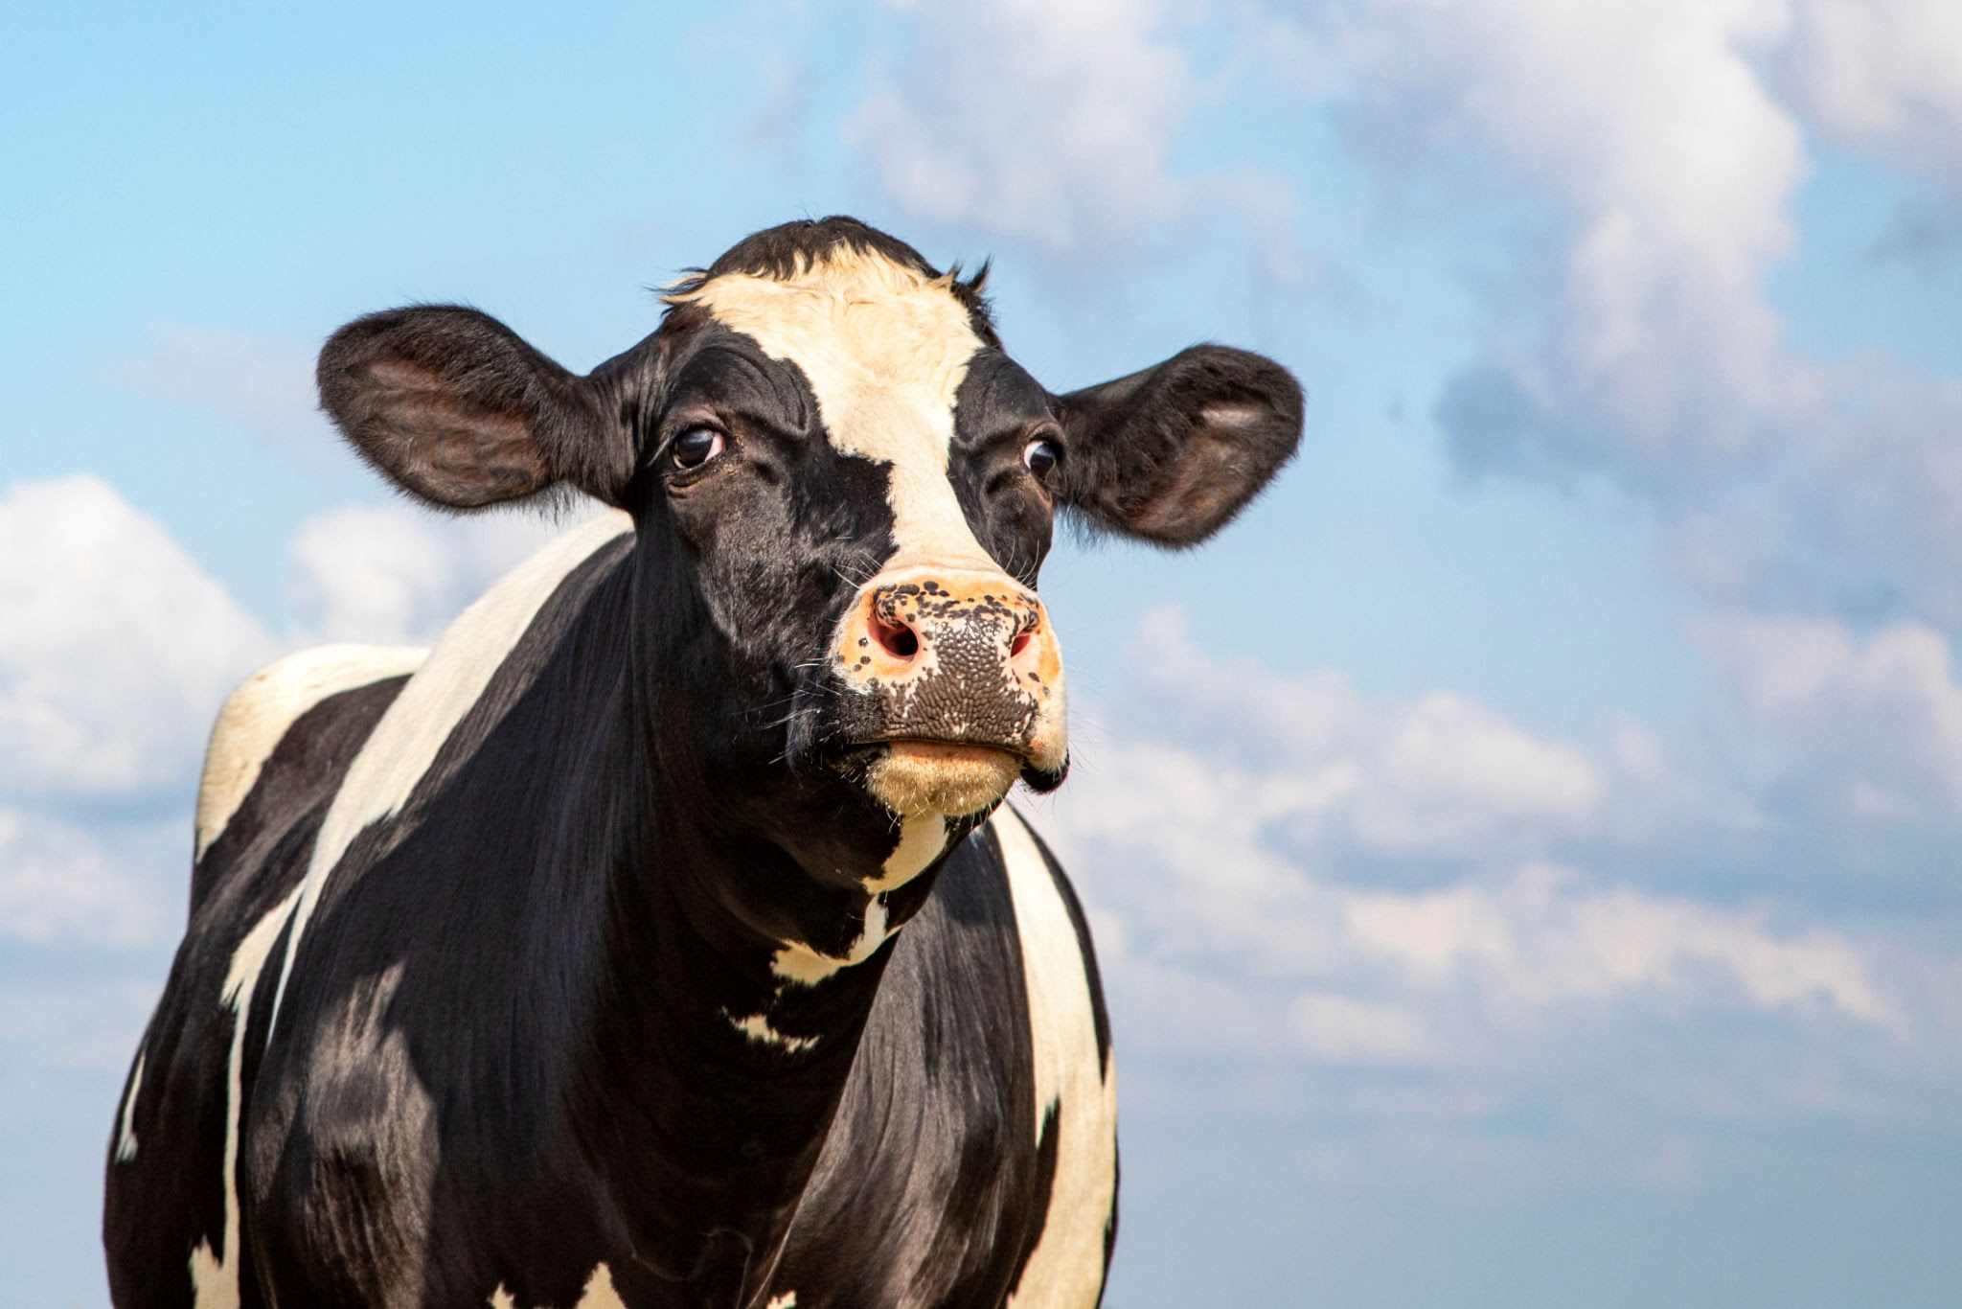
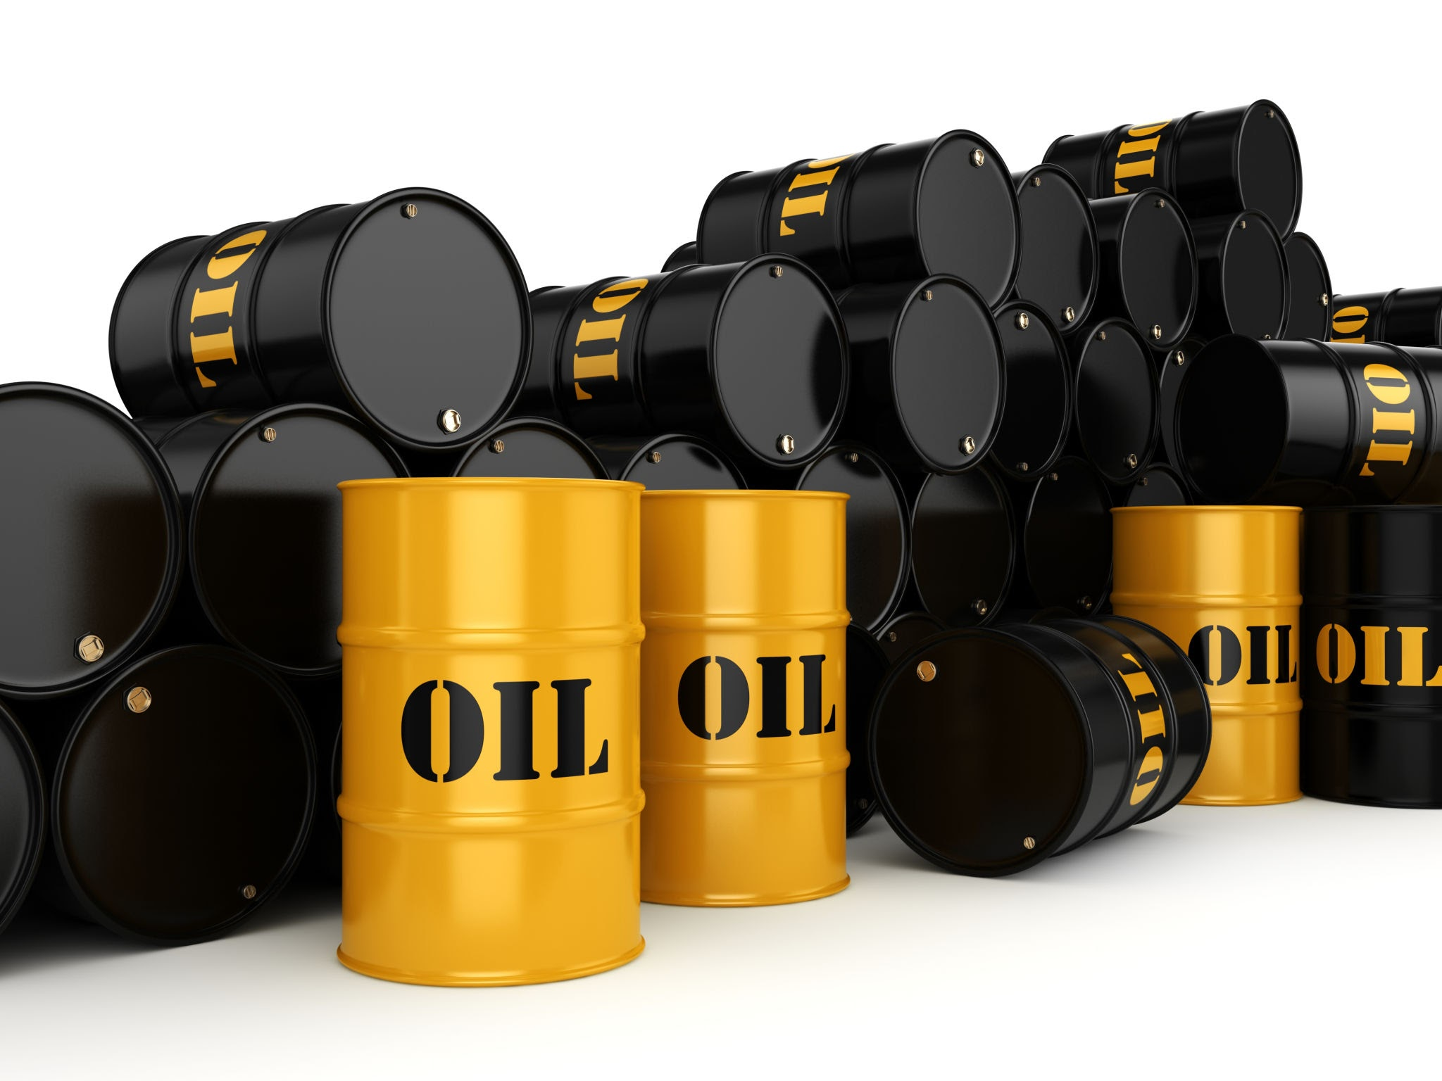
Notes:
Ask group to describe each picture - what does this represent? How does this cause climate change? Looking for ‘carbon dioxide’ or ‘fossil fuels’ to be mentioned if possible.

Slide 9
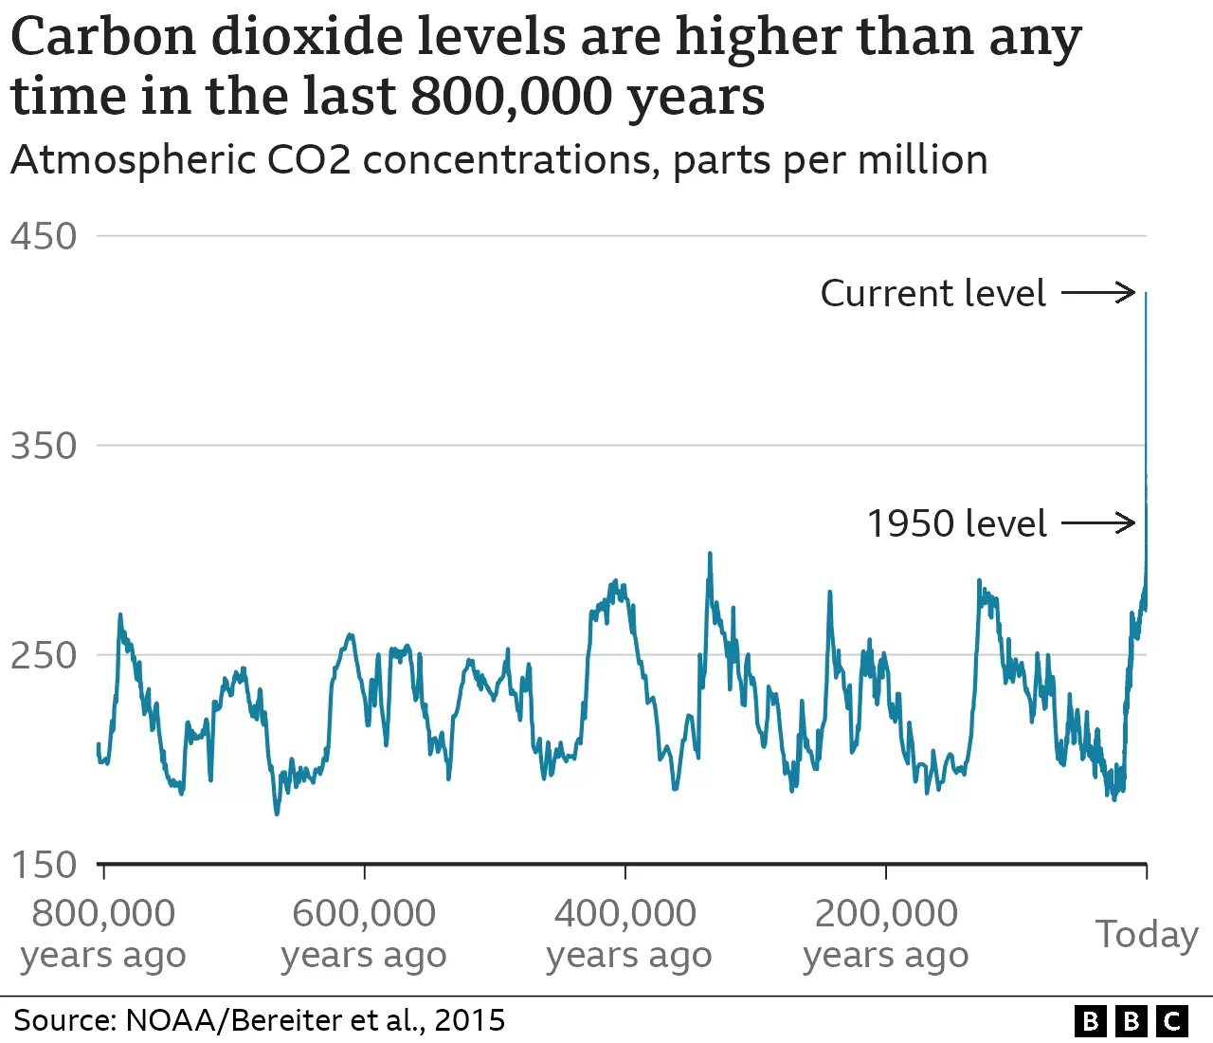
Watch this video on fossil fuels
Notes:
Watch the bitesize video (aimed at Scottish Schools but information relevant to all).
The use of fossil fuels - coal, oil and gas - in homes, factories and transport over the last 100 years has caused a rise in Carbon Dioxide levels in our atmosphere. When fossil fuels burn, they release greenhouse gases - mostly Carbon Dioxide - which trap the sun’s heat causing the planet’s temperature to rise.
Talk through this slide. What are fossil fuels (why are they called this?), What do we use fossil fuels for? Carbon dioxide is a gas that causes the earth’s temperature to rise. Look at graph - highs and lows but spike to today’s high level.

Slide 10
What are the effects of Climate Change?
Notes:
Elicit answers from group

Slide 11
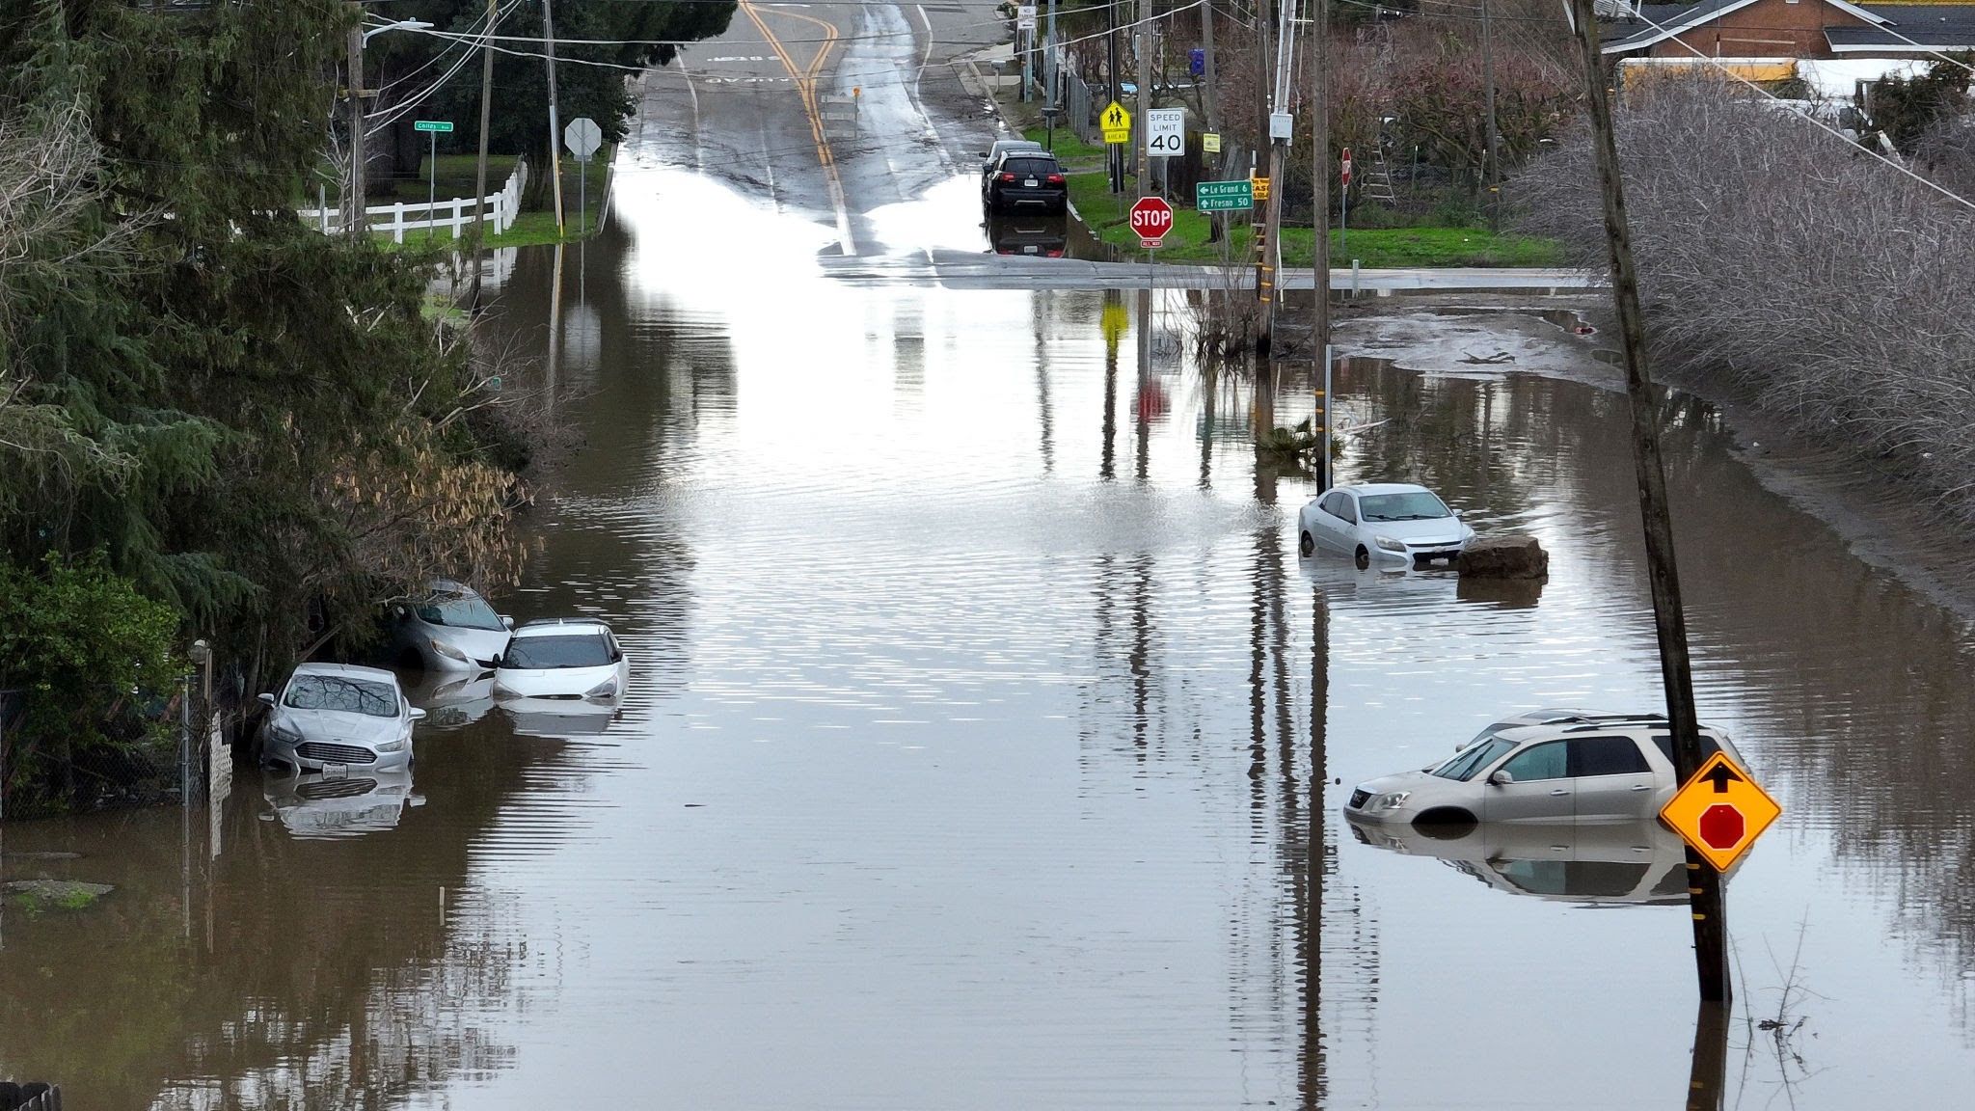
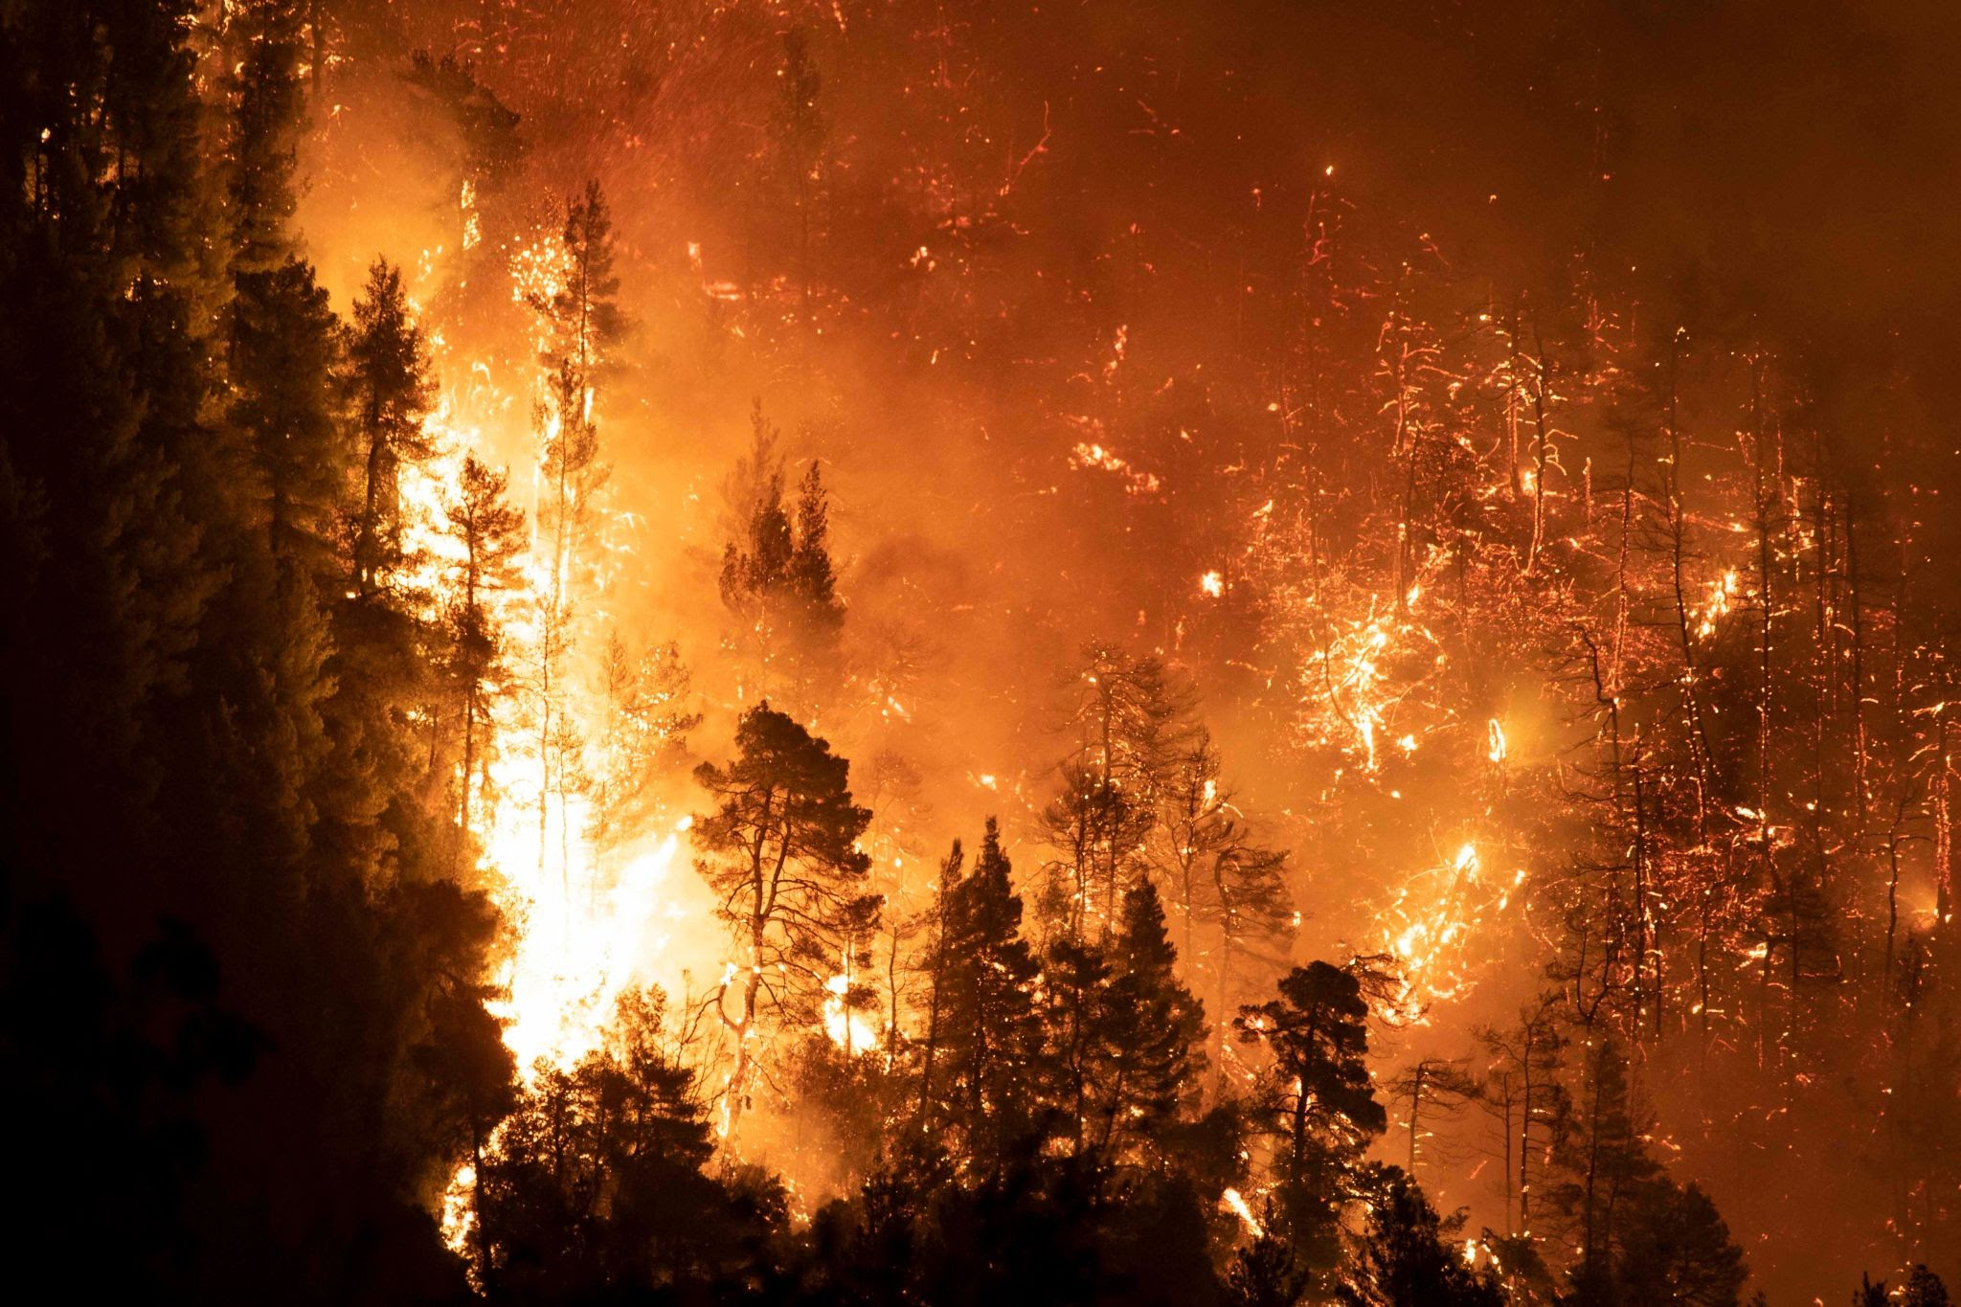
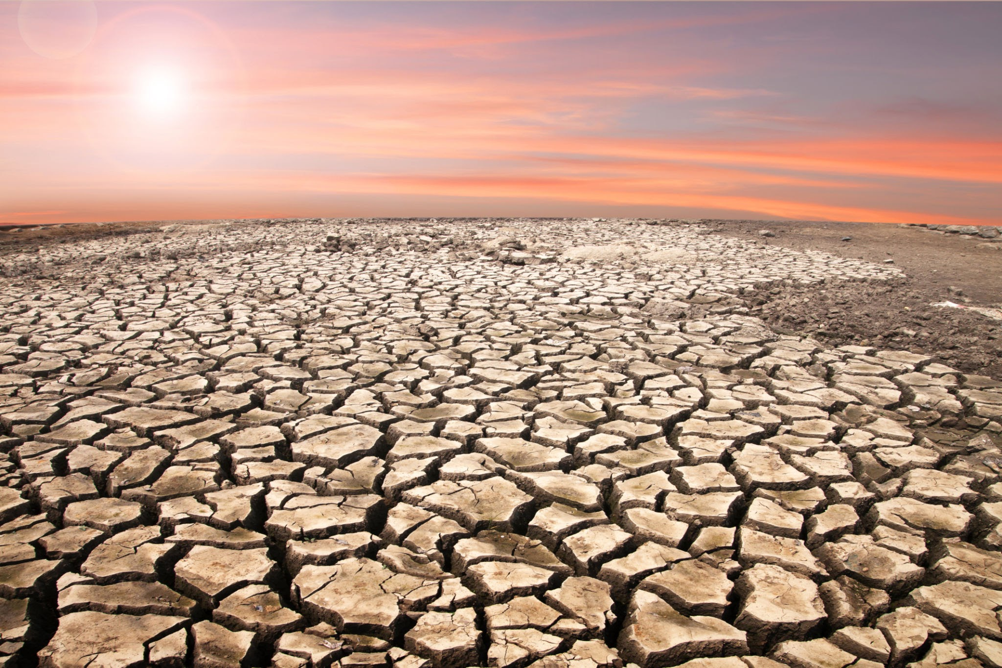
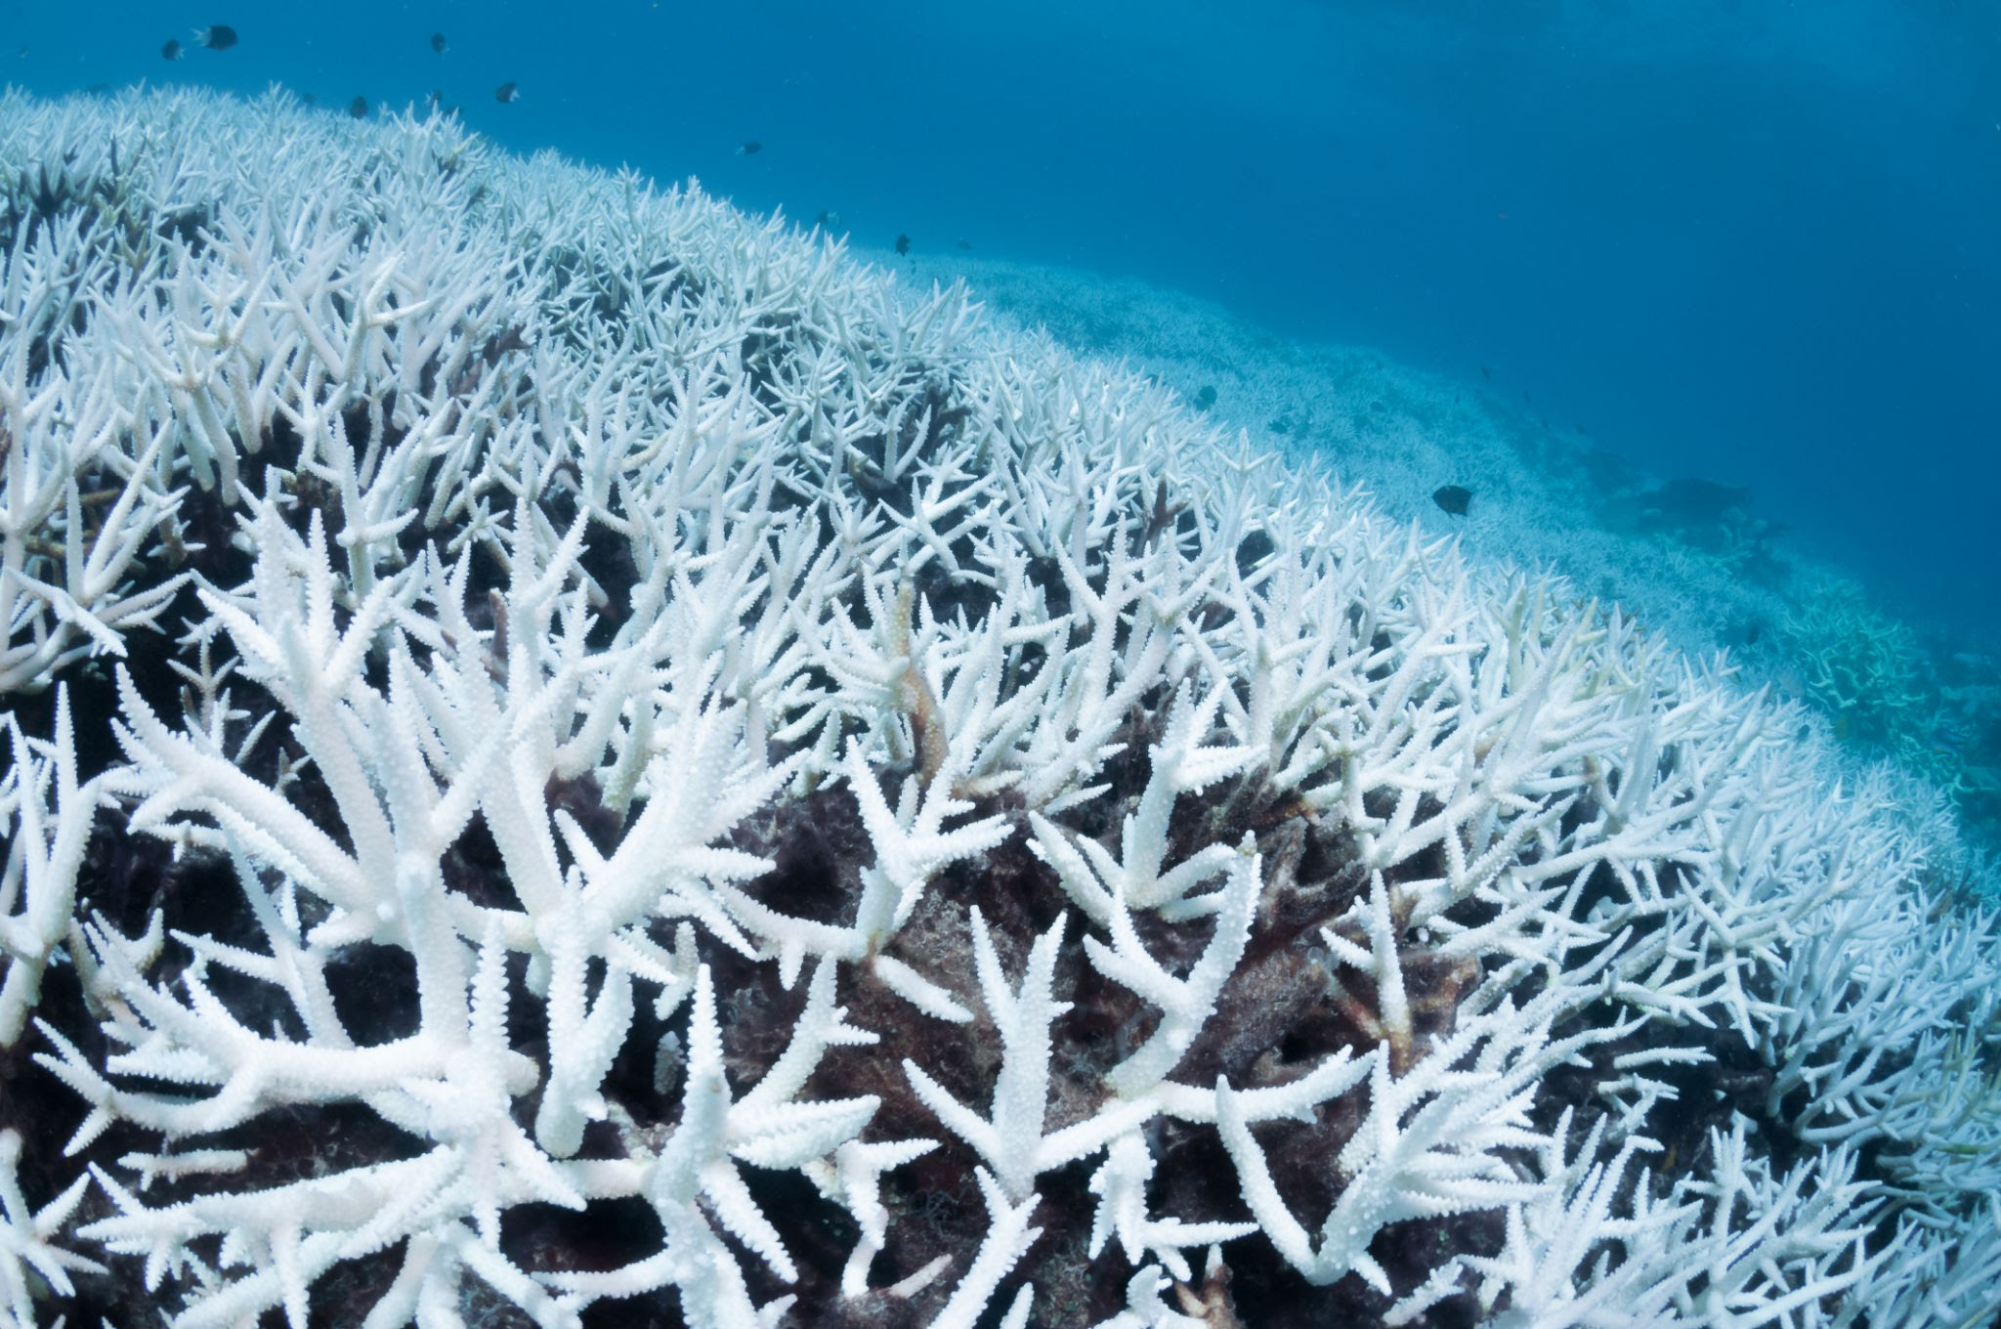
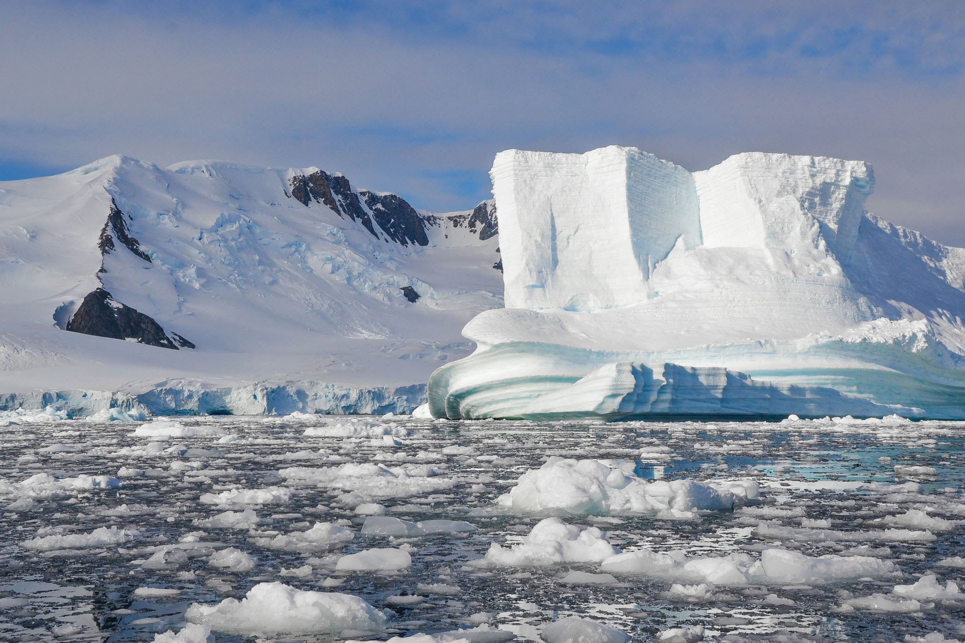
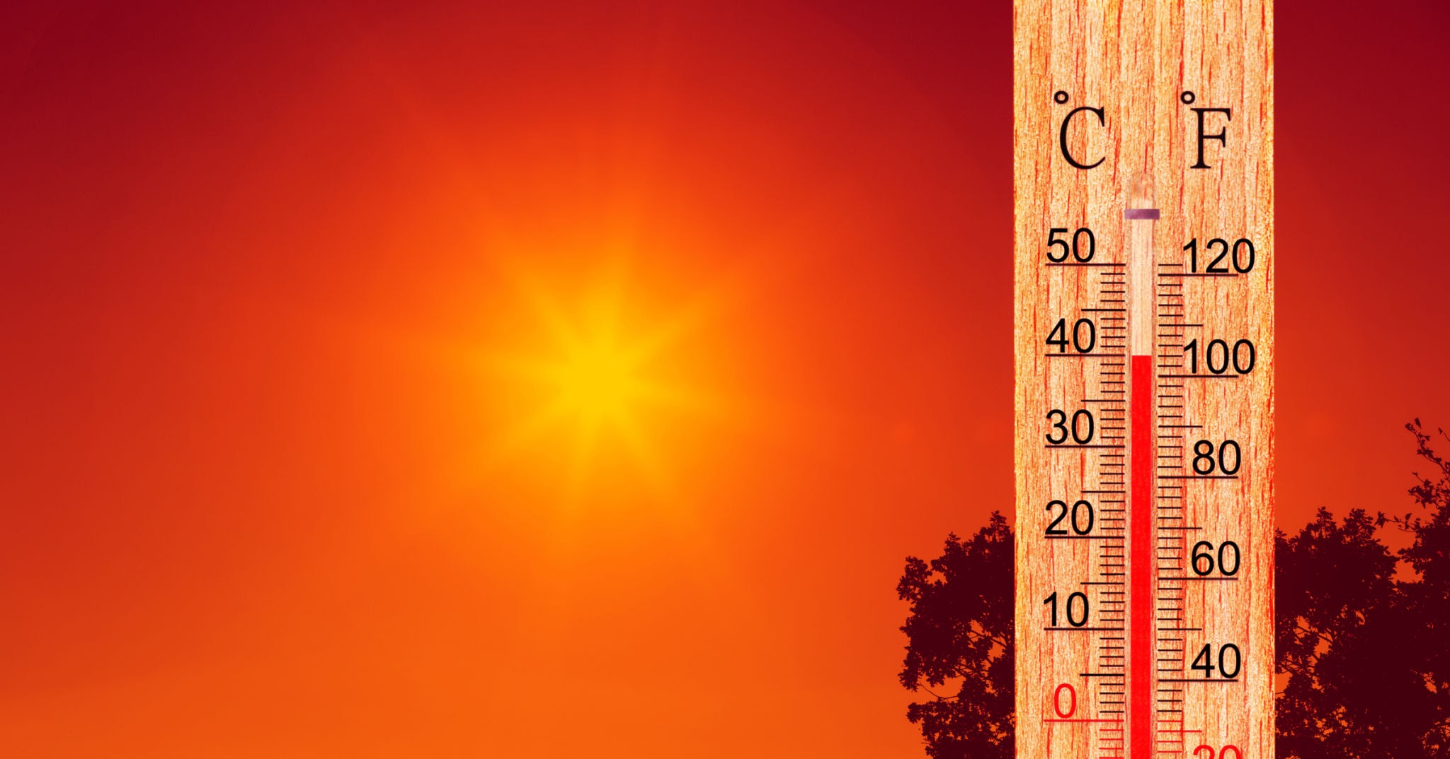
What are the effects of climate change?
Notes:
Talk through each photograph - more frequent extreme weather events such as heatwaves, wildfires, drought and floods; Rapid melting of ice sheets and glaciers causing sea levels to rise; Decline in Arctic sea ice; Marine Heatwaves and ocean warming; Coral bleaching; Changes in animal and plant ranges.

Slide 12
What can I do?
Notes:
Elicit answers from group - make note of group ideas / split into groups to make posters / ask individuals to write on post its to make group idea board.

