Slide 1


Ocean and Carbon Literacy for Coastal Communities
How climate change is affecting our seas and what we can do about it.

Slide 2
Plastic Planet
Part Four
And what I can do

Slide 3
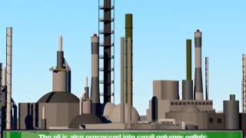
How is plastic linked to climate change?
Notes:
Ask how plastic contributes to climate change. How is plastic made? What is the main ‘ingredient’ of plastic - oil!
Watch the video to learn more about how plastic comes from oil. (this video has no narration but uses subtitles. For younger children it
may be necessary to read the subtitles out as the film progresses.)

Slide 4
What other ways does plastic contribute to climate change?
Notes:
In the final part of this video, it explores how plastic ends up in landfill and can be burnt. Ask group what the alternatives are - recycling and reusing. Highlight how this prevents more oil being used to make fresh plastics, and therefore prevents CO2 being released into the atmosphere. (The video focuses on the US but is relevant to everyone.)

Slide 5

Notes:
How can we do this - elicit ideas from the group.
Reduce - use plastic alternatives eg: paper bags, glass bottles, bamboo toothbrushes.
Recycle - Always recycle where possible. If there is no recycle bin - take it home. Make sure you put your recycling in the correct bin.
Reuse - Instead of throwing something away, reuse it when you can. Eg: water bottles, clothes, toys

Slide 6
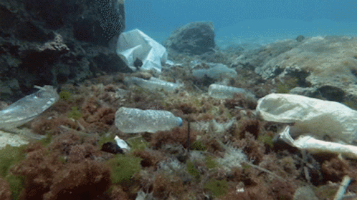
Plastic in the Sea
Oceans - the plastic problem
Notes:
Watch the video from the link - BBC Bitesize video on the problem of plastic in the sea.
Discuss how plastic gets into the sea. What can we do?
Talk about how plastic can affect marine wildlife. (entanglement, ingestion - use the images from the worksheets to help)

Slide 7
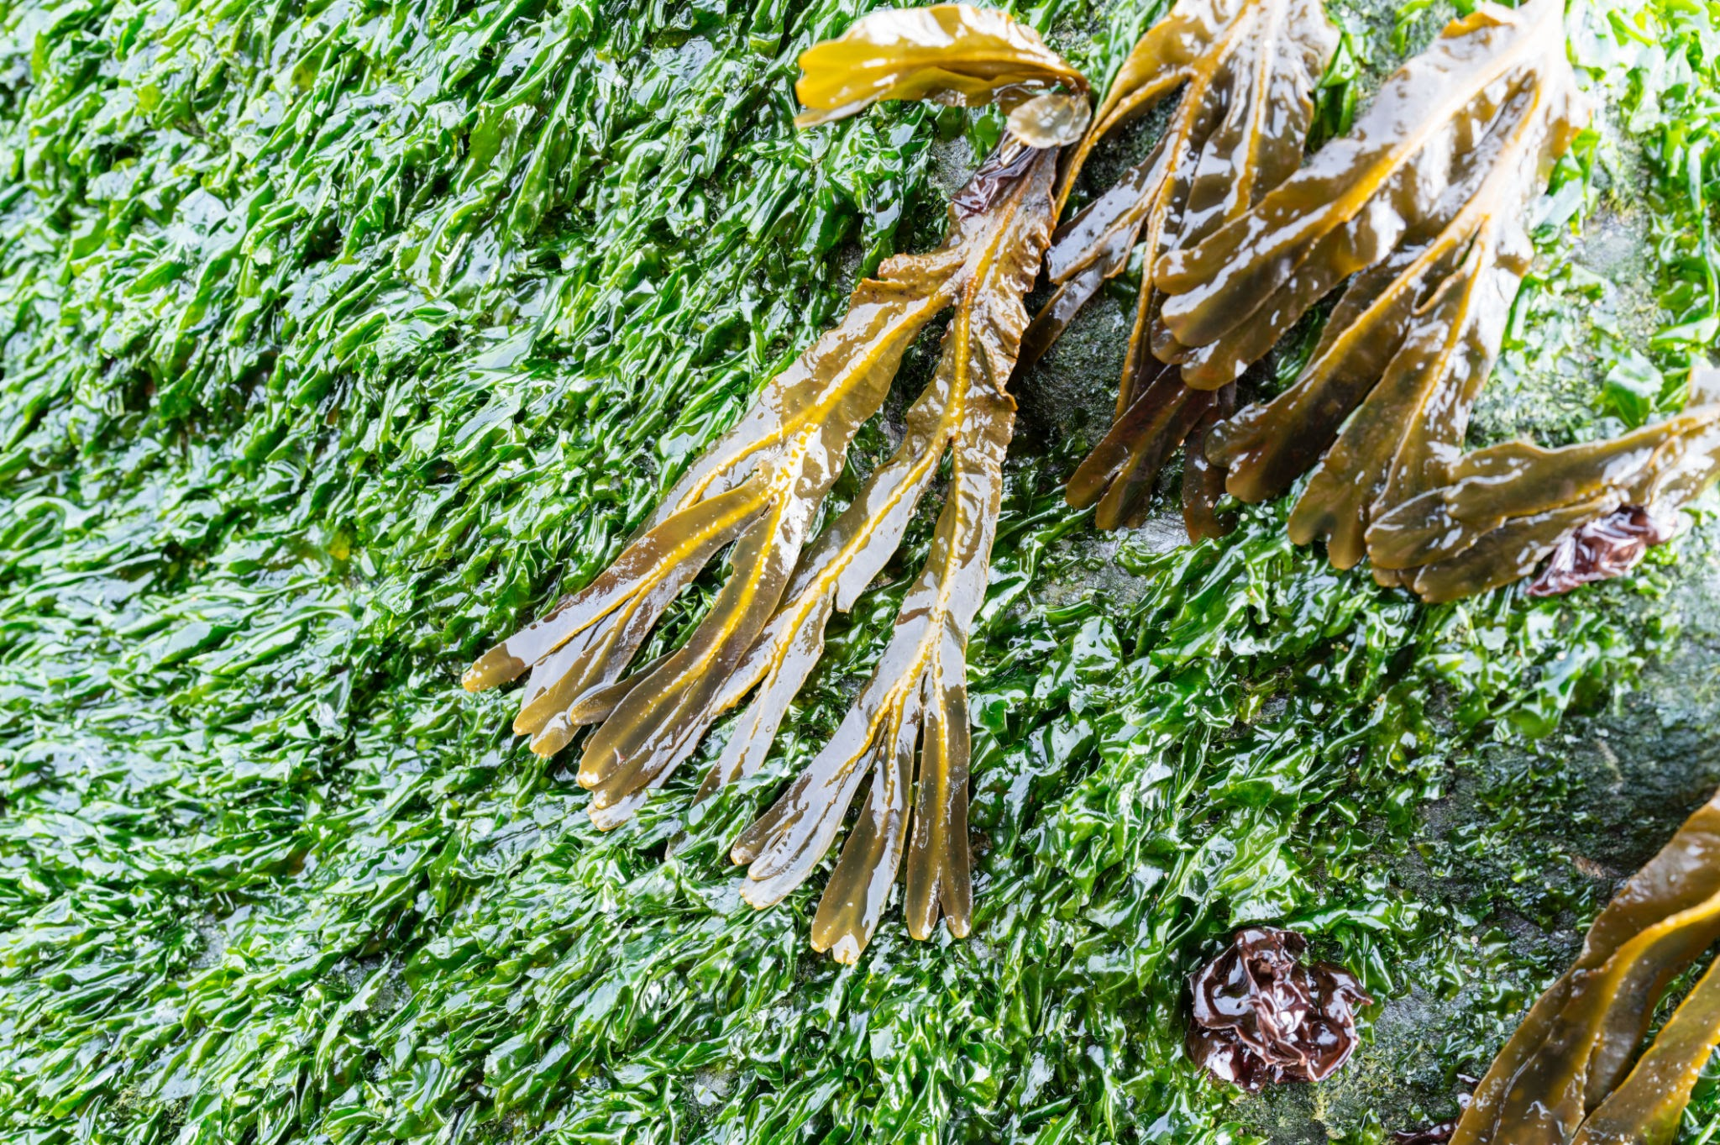
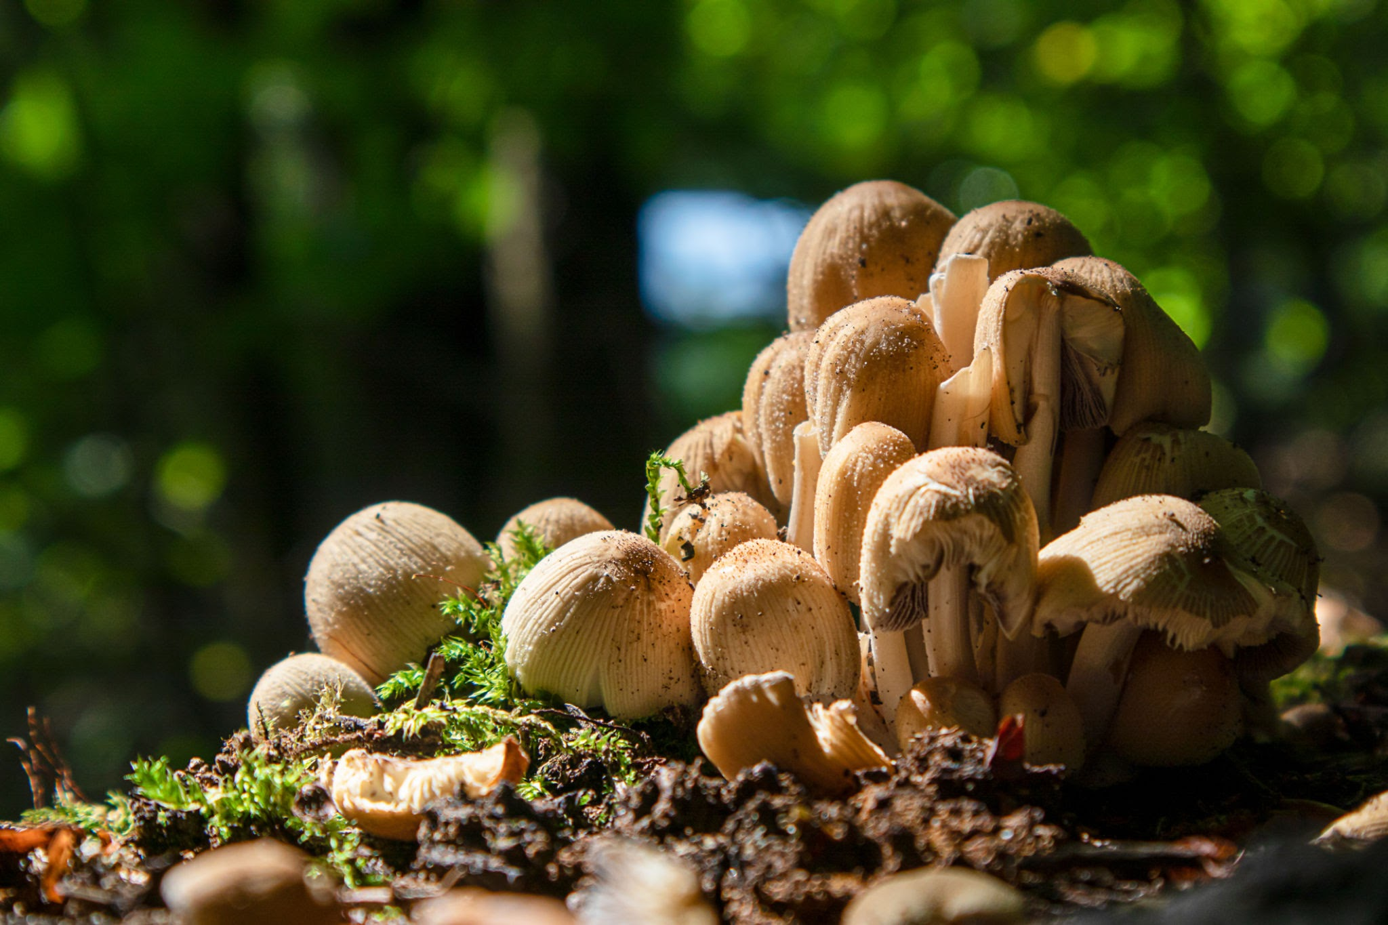
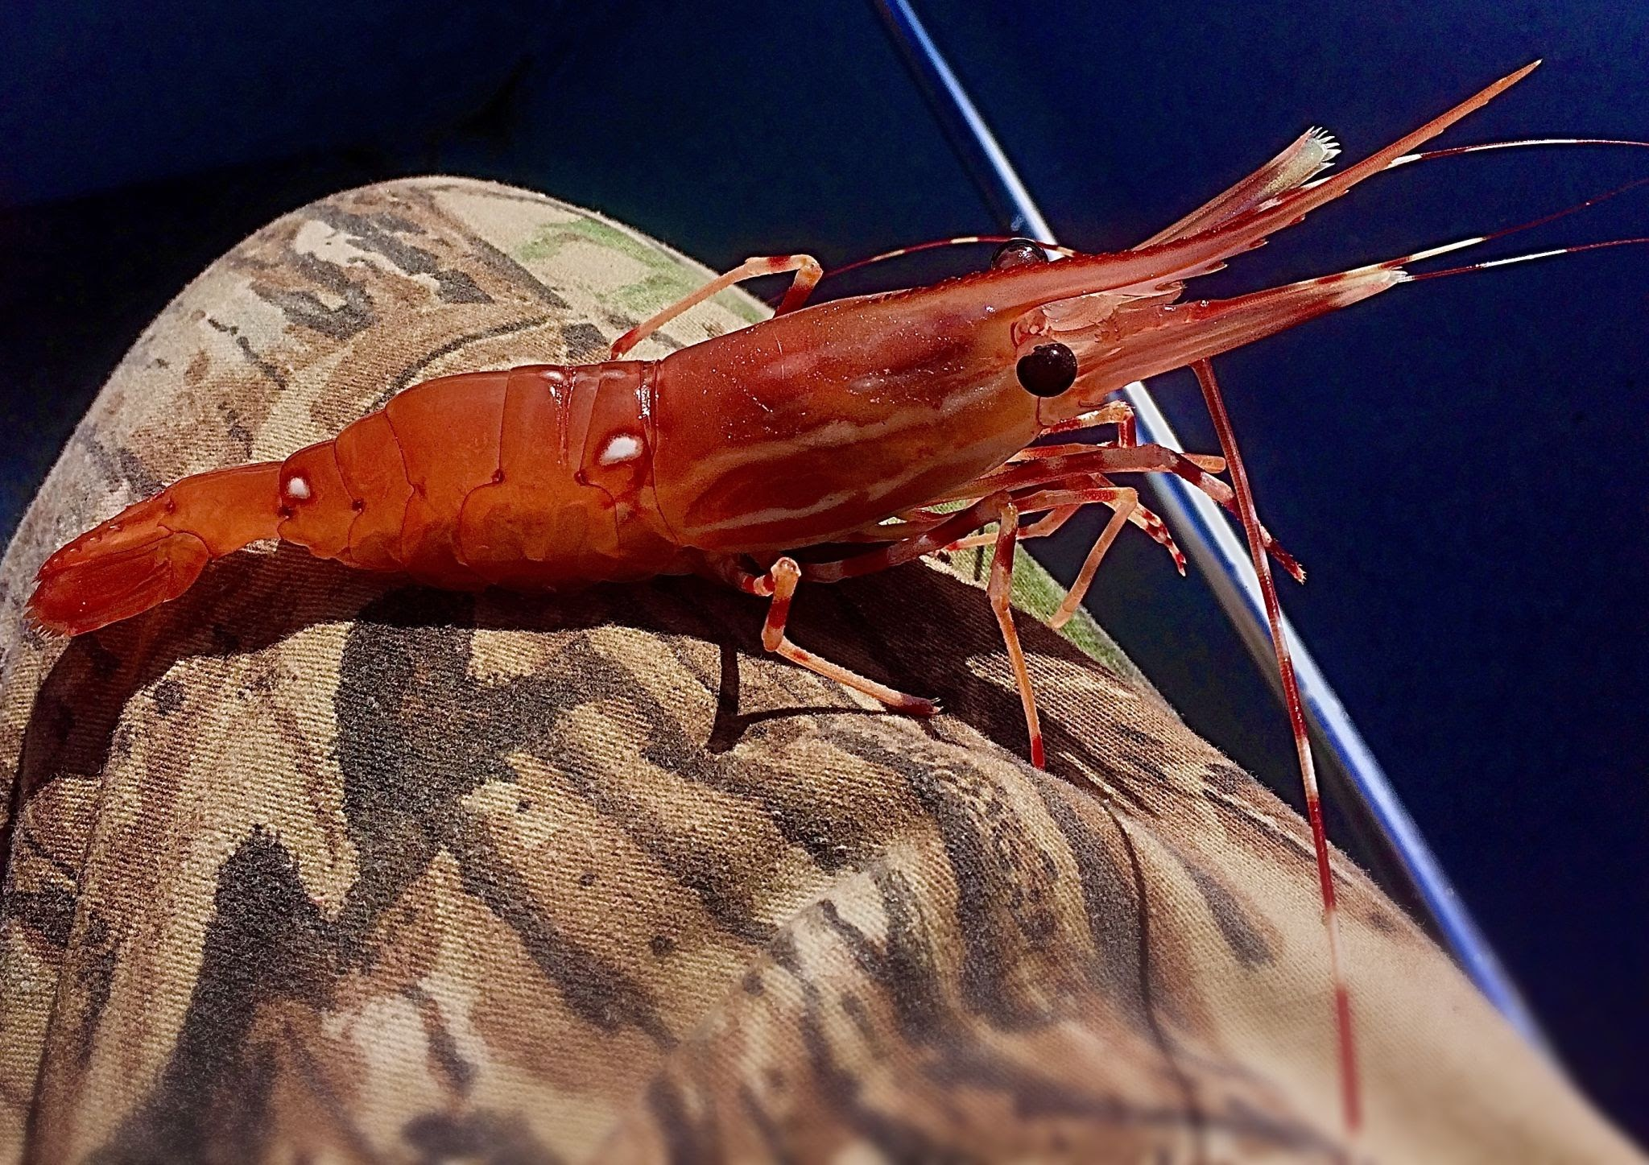
Alternatives
Notes:
What do all of these things have in common? Scientists have found a way to make a plastic alternative out of all of these natural alternatives - seaweed, mushrooms and prawn shells!
Discuss what might be the positives and negatives of bioplastic - what it could be used for and what it could not be used for.

Slide 8
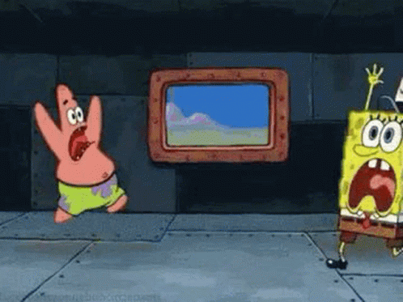
Don’t panic!
Notes:
Use this slide to discuss how we might feel worried about climate change and the problems that face the world and our seas. Reassure group that many people are fighting and doing what they can to stop these worrying changes. Open up discussion on what little things each individual can do to help.
If you are worried:
Talk to an adult
Get involved in positive change - join an eco group or make eco friendly changes in your house
Encourage your school or community to make changes

Slide 9
"I have learned you are never too small to make a difference."
Greta Thunberg

