Slide 1


Ocean and Carbon Literacy for Coastal Communities
How climate change is affecting our seas and what we can do about it.

Slide 2
Part two
How is the ocean affected by climate change?
Notes:
In this section we are going to look at the effects of climate change on our Seas.

Slide 3
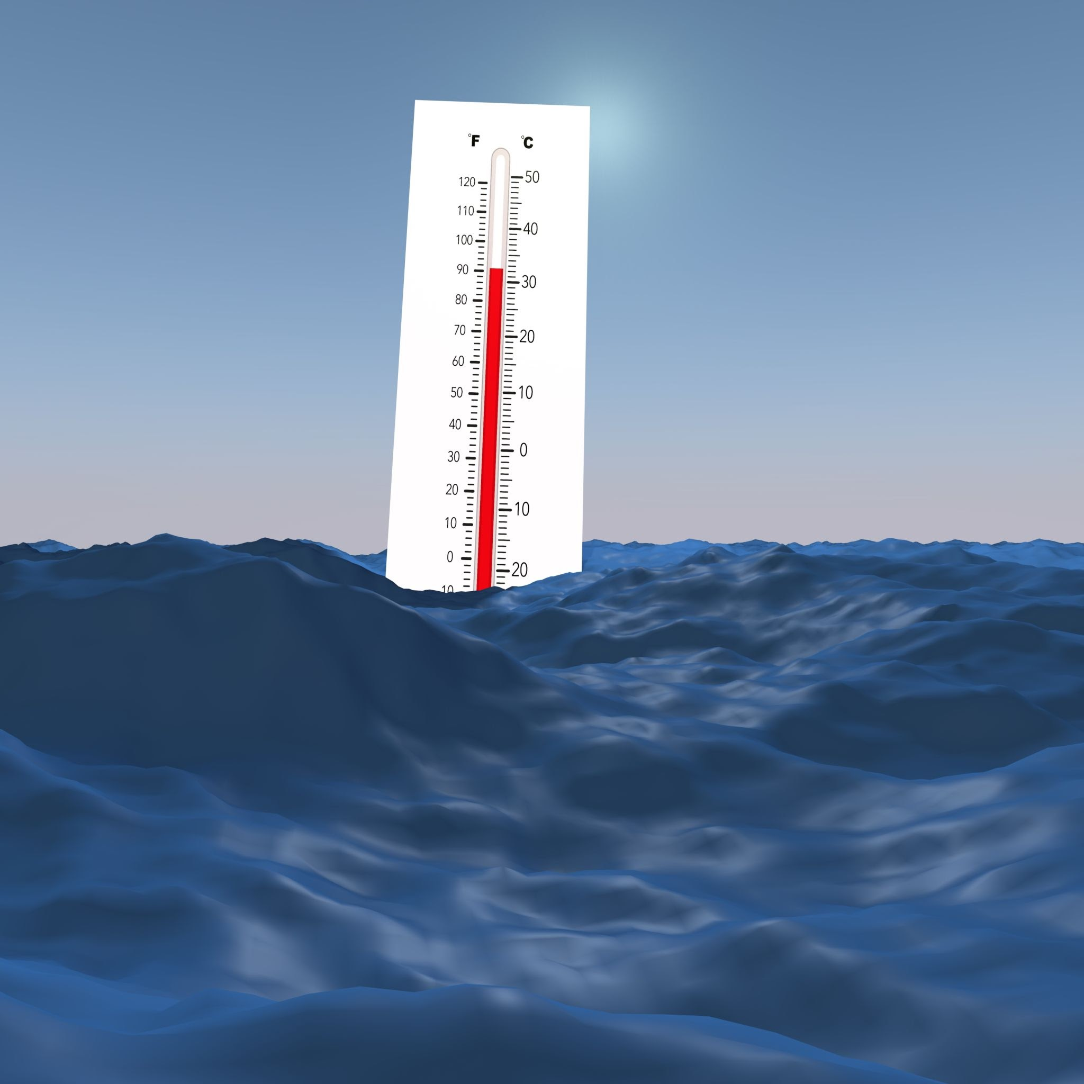
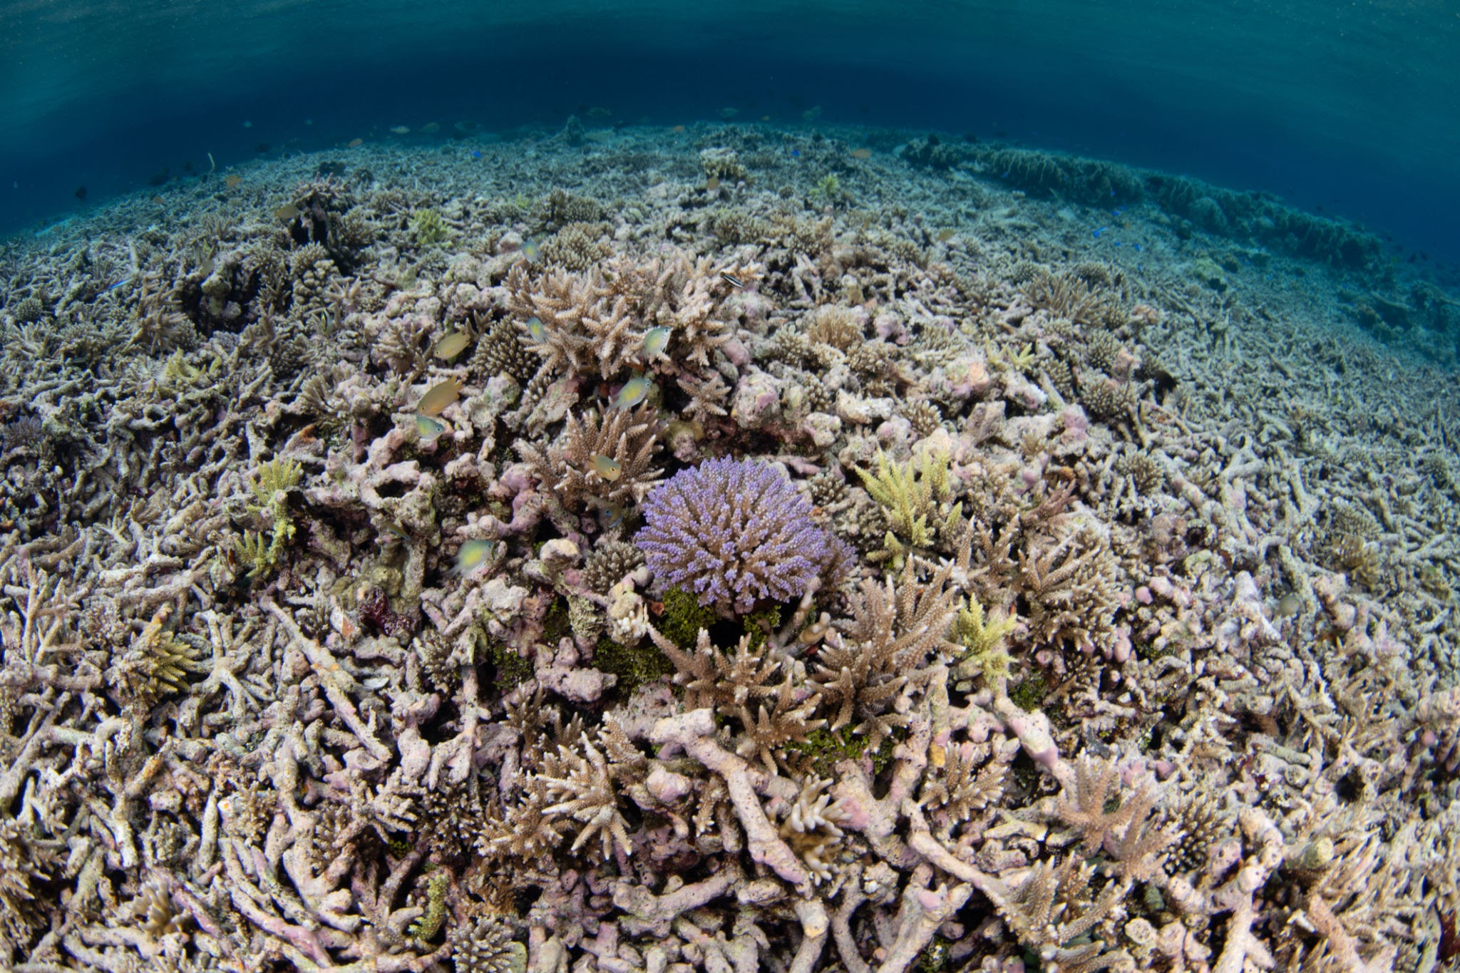
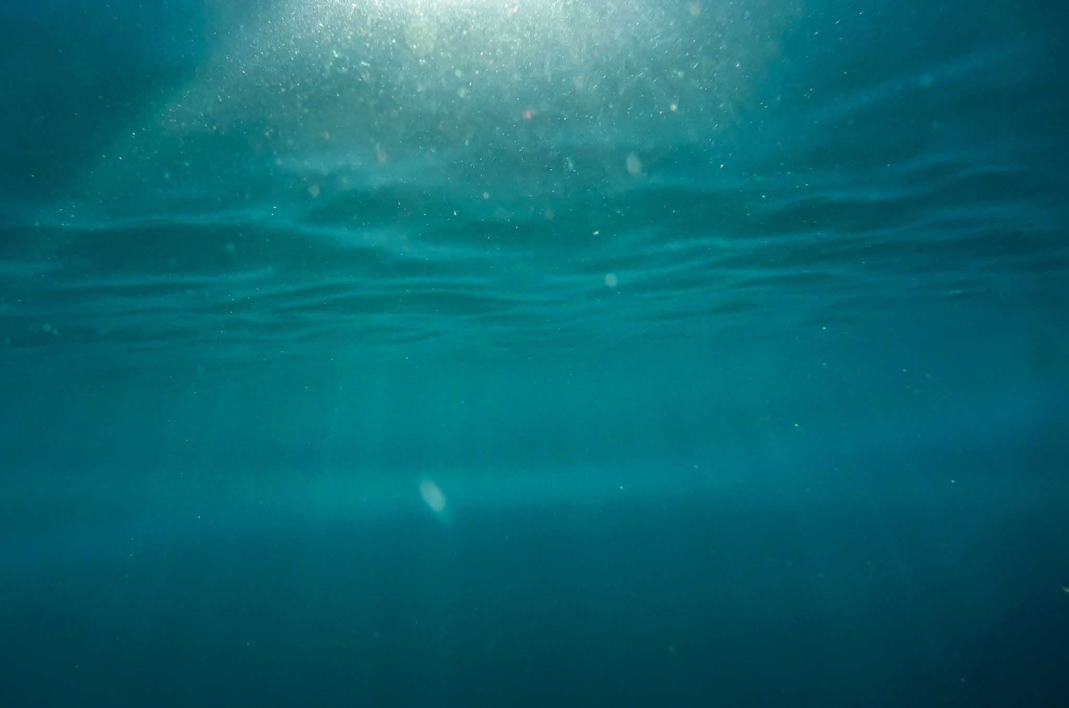
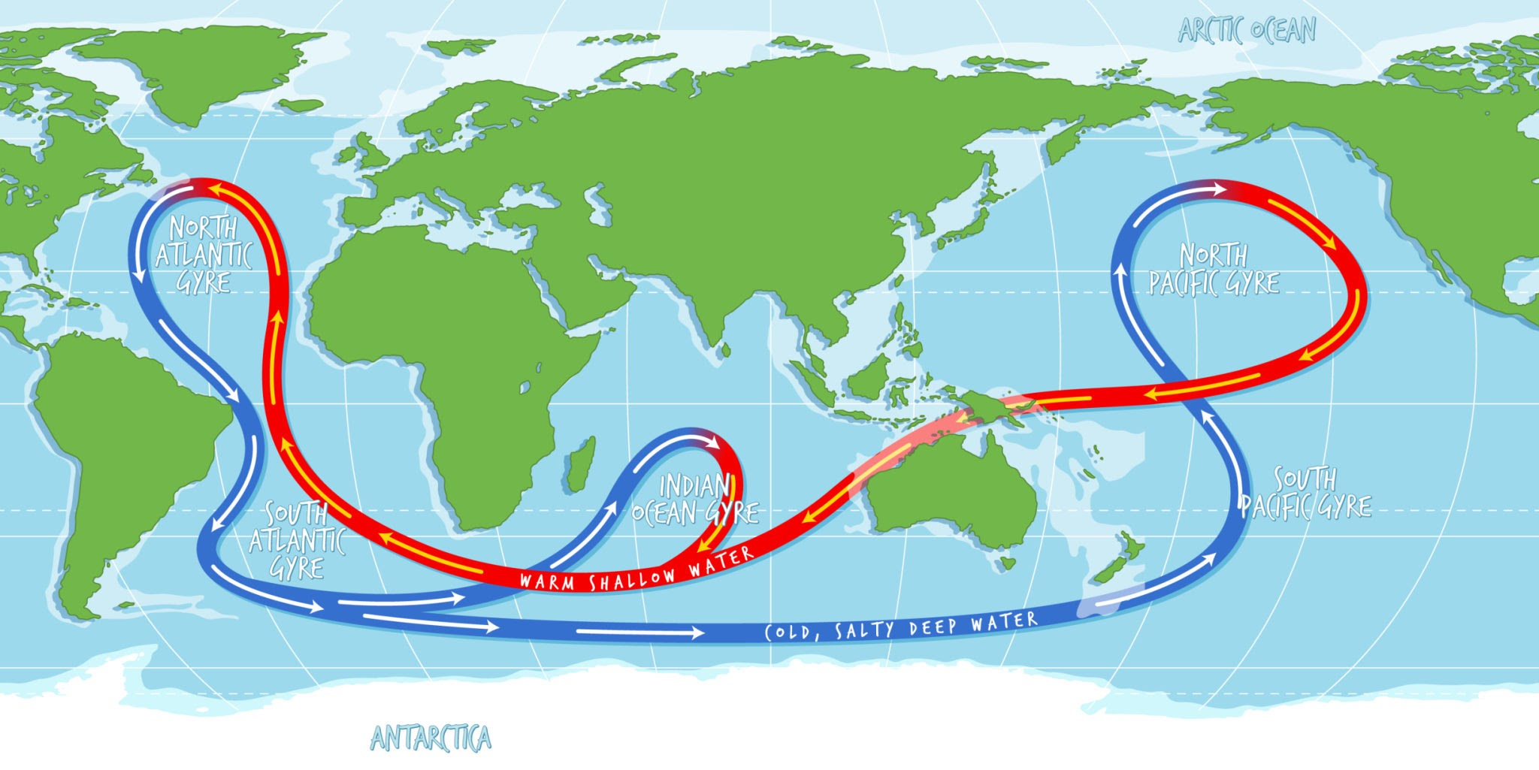
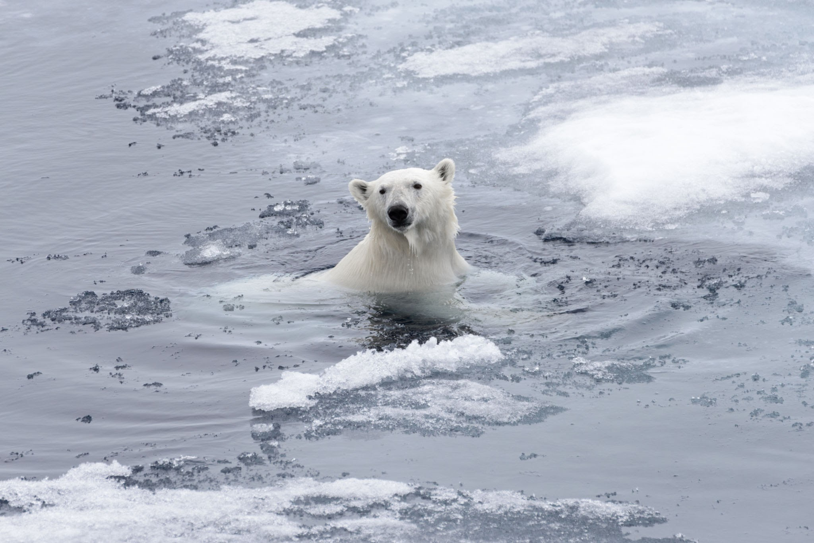
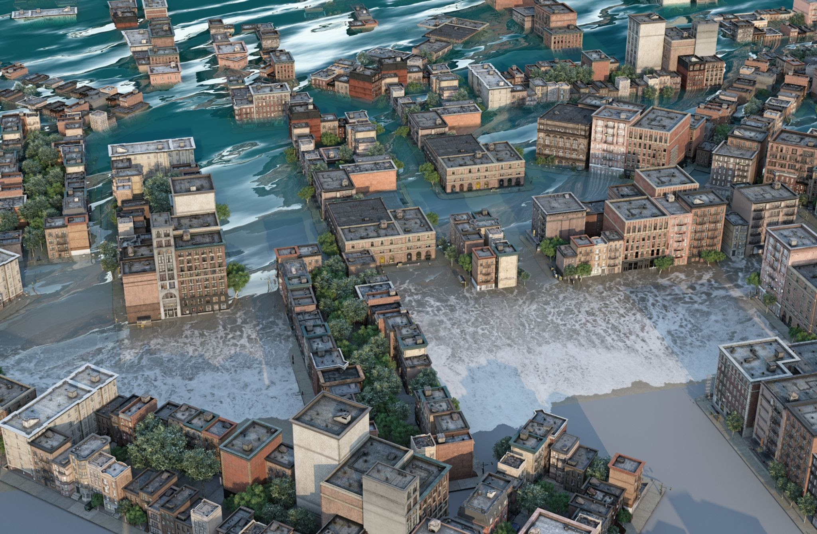
Notes:
Elicit ideas from the group of what each of these pictures represents. Sea temp rise, loss of biodiversity (empty oceans), coral bleaching, change in ocean currents, warming oceans, melting ice caps, sea level rise

Slide 4
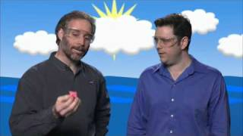
Rising water temperatures
;
Watch how water is better than air at absorbing heat.
Notes:
Water has a huge capacity to absorb heat. 90% of the excess heat created by climate change is absorbed by the ocean. We really do rely on the seas to keep the planet stable.

Slide 5
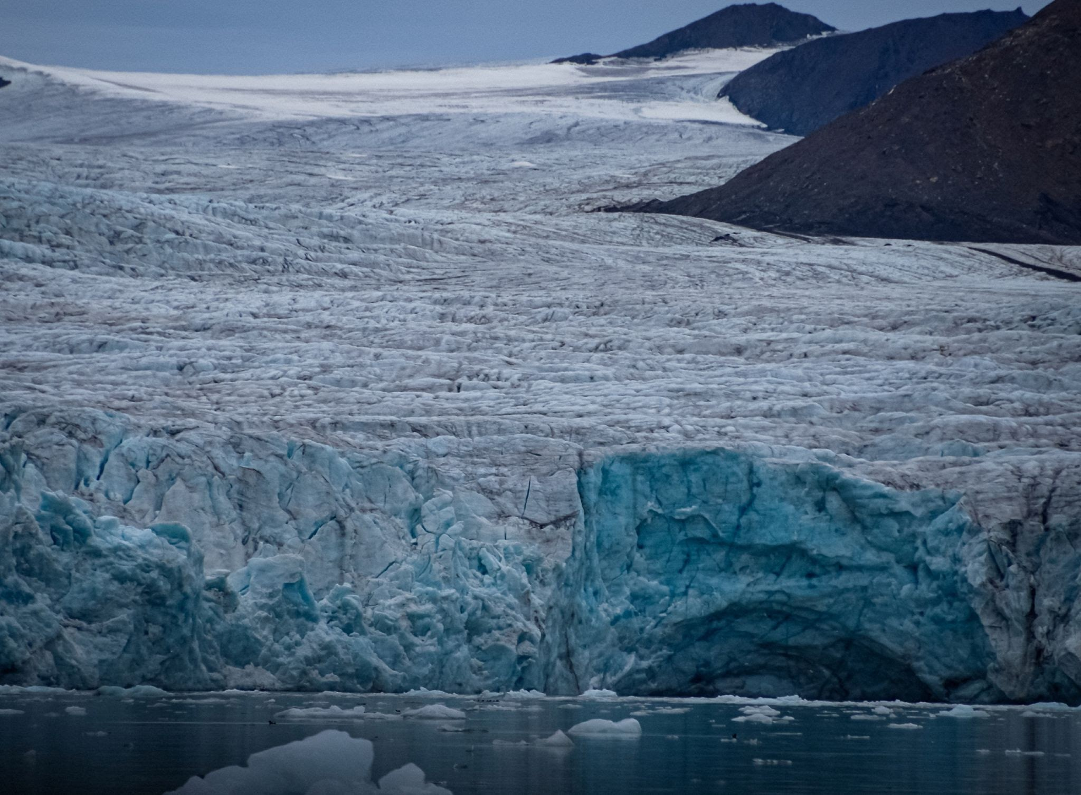
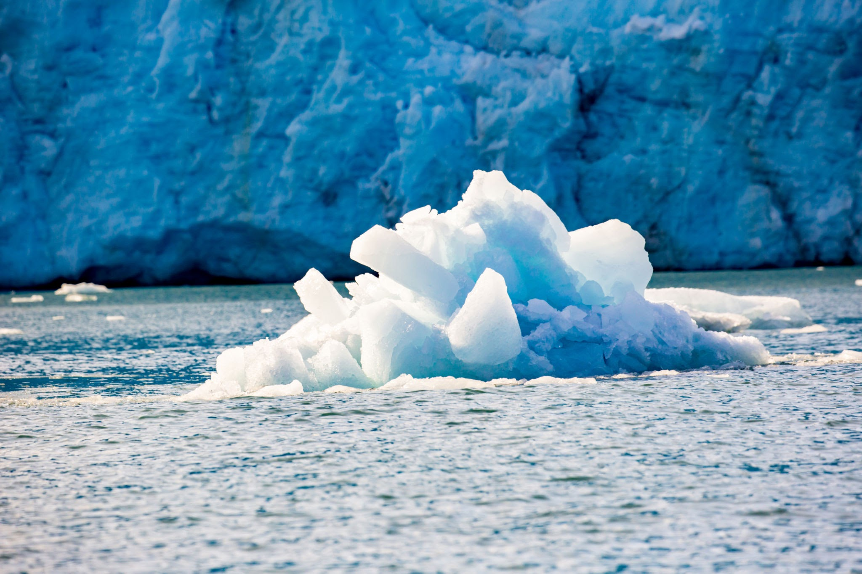
Warming seas can lead to sea levels rising for 2 reasons
Melting ice
Thermal expansion
What problems come with rising sea levels?
Notes:
Thermal expansion - refer back to previous slide video. Warming water expands, taking up more room.
Melting ice - highlight difference between land ice (glaciers) and sea ice (icebergs and frozen seas)
Look for answers such as - coastal areas could end up flooded or underwater, loss of food growing land, people having to move - mass migration, loss of habitat for animals too.
Following this slide - can do thermal expansion and melting ice experiment (see info sheets)

Slide 6
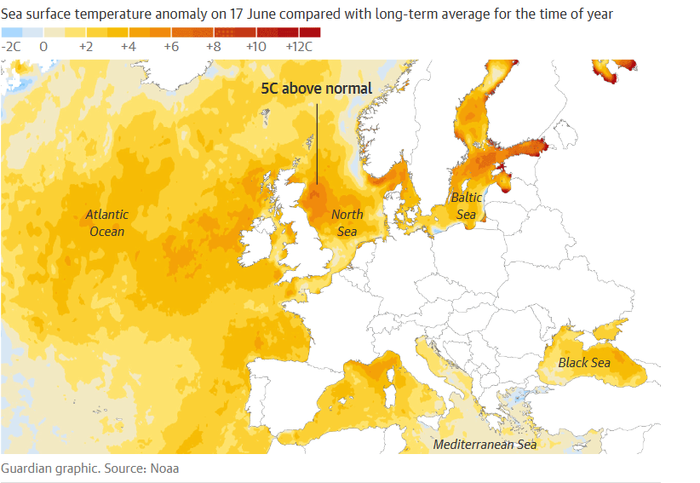
Marine Heatwaves
Notes:
Climate change is causing the temperature of the sea to rise. This map is from June 2023 when seas around the UK saw record temperatures for short periods of time - marine heatwaves. How can high temperatures affect life in the sea and as a result - us?
Link the damage done by heatwaves on land and wildfires on land to a similar level of damage beneath the surface of the sea. Ask pupils to think about a heatwave on land - what would happen here? Plants would die = lack of food. Animals can’t cope with increased temperatures = mortality. If ocean food chain is affected this can affect our fisheries - food stability for humans and economic impact eg: on fisheries.

Slide 7
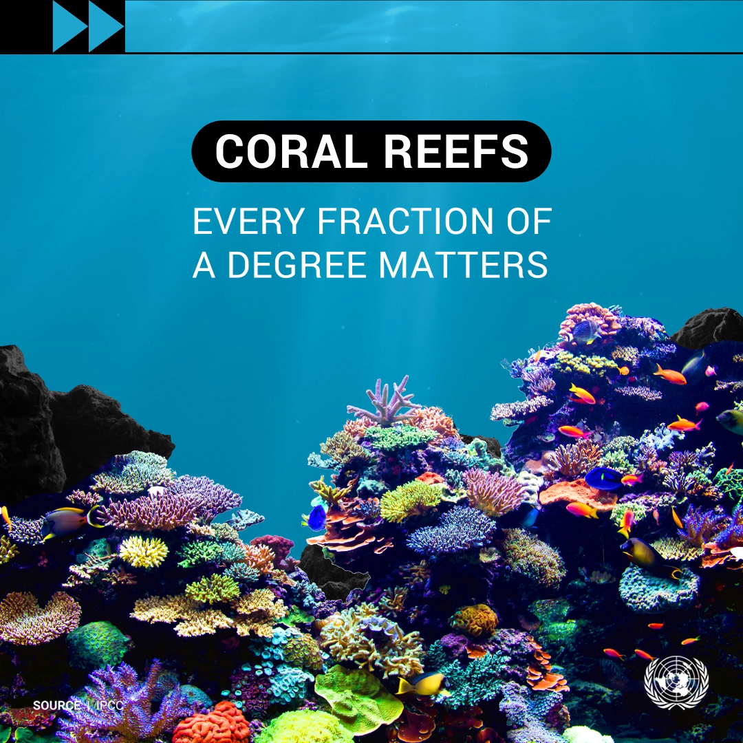
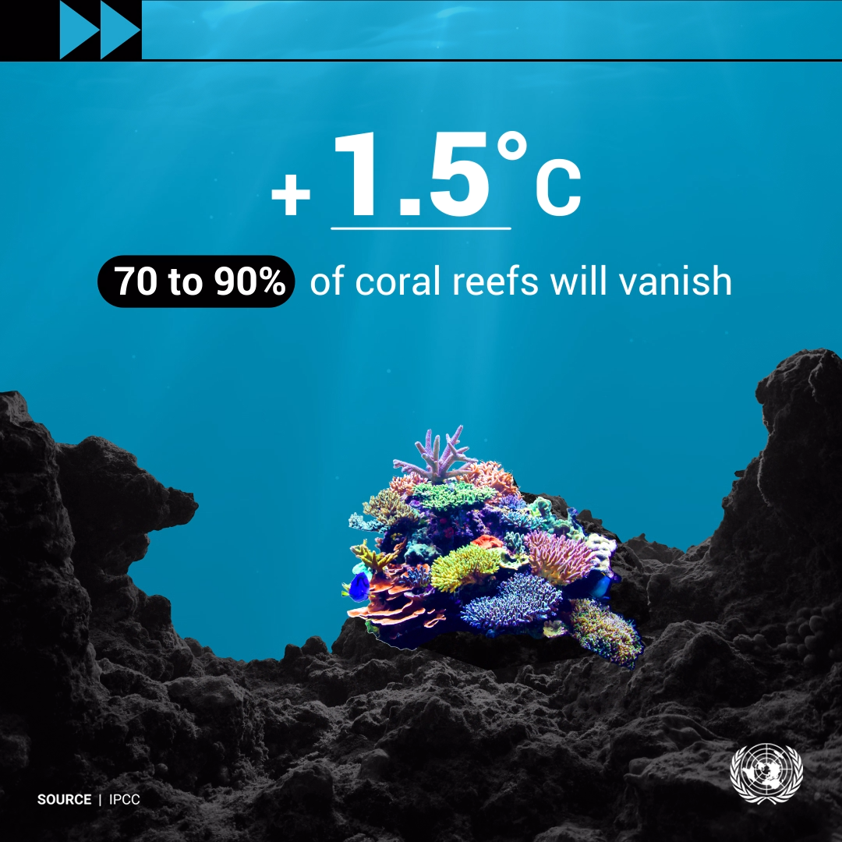
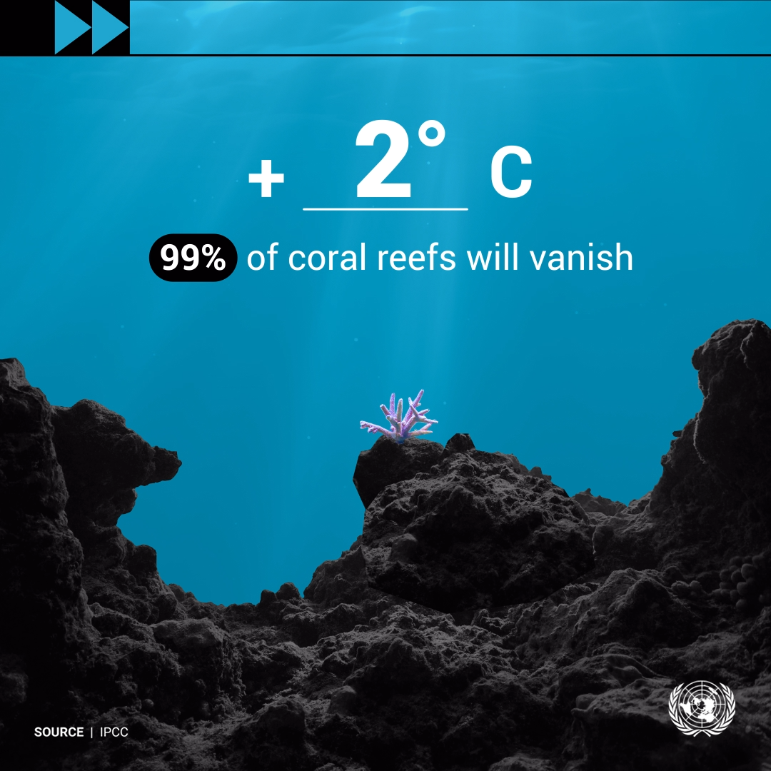
Notes:
Over time sea temperatures rising can affect life in our oceans. For example on coral reefs. These images show the effect of what we might perceive as slight temperature increases. Coral reefs are homes for many animals = loss of biodiversity.
Another result of climate change can also impact coral reefs…..leads to next slide.

Slide 8
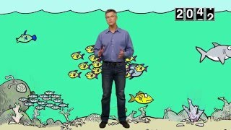
Ocean Acidification
Notes:
Ocean acidification is the reduction of the ph of the ocean over an extended period of time, this is caused primarily by the ocean absorbing increased amounts of carbon dioxide from the atmosphere.
This harms life forms that rely on carbonate based skeletons and shells - urchins, corals, crabs, limpets etc. This also harms organisms higher up the food chain that feed on these organisms.

Slide 9
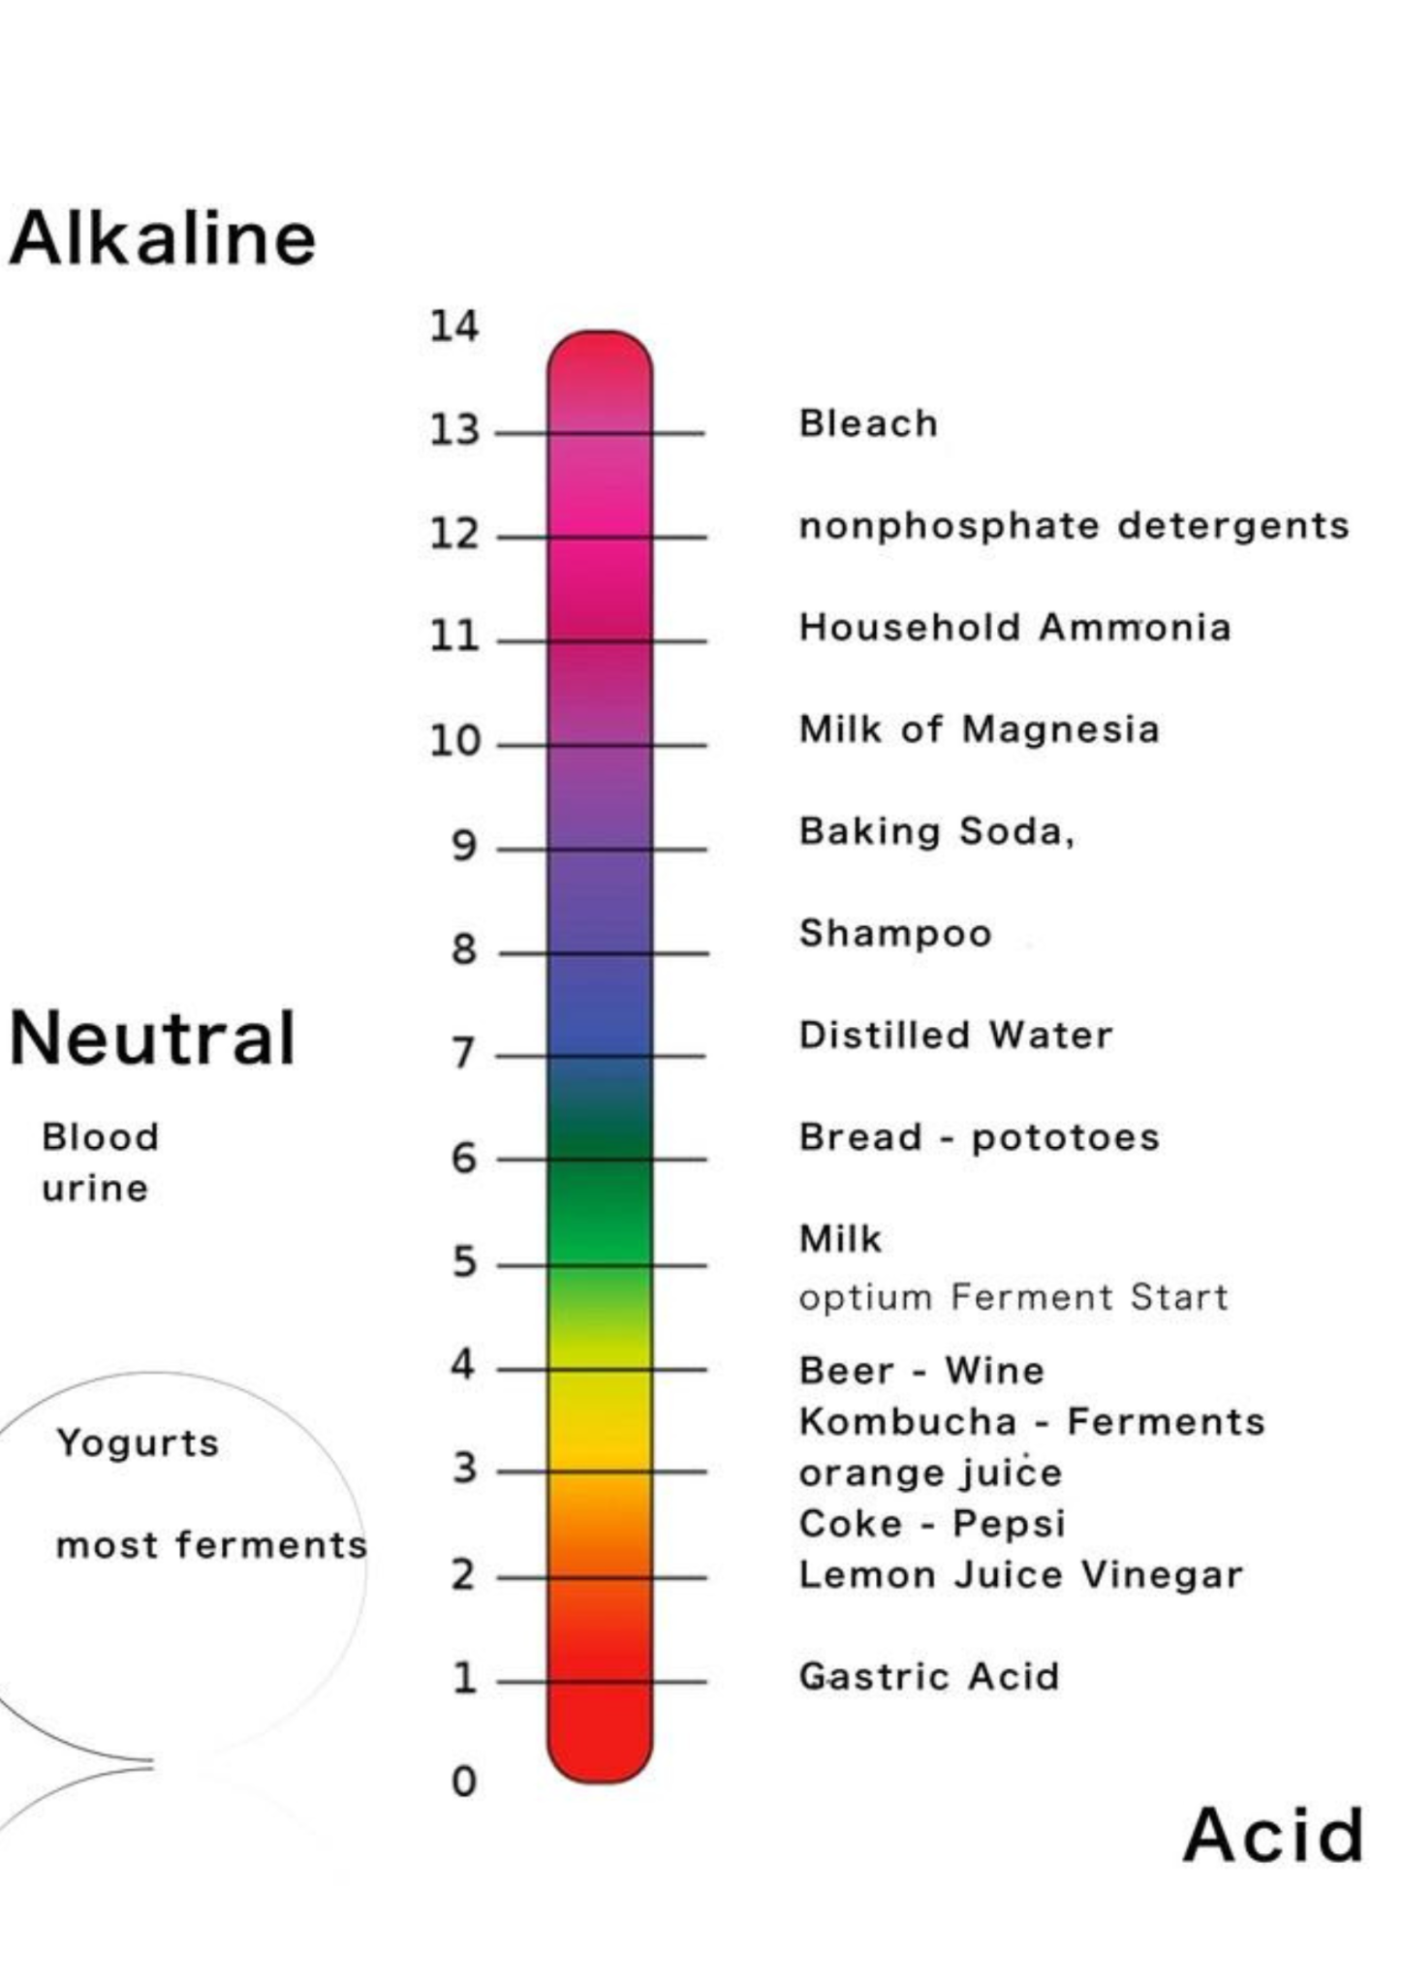
Before humans started burning fossil fuels around 200 years ago, the ph of the sea was 8.1. Today is is 8.0 - which means that the sea is becoming more acidic.
What damage can be done to sea creatures as a result of this?
Notes:
Ocean acidification can damage the shells of some creatures
Follow this slide with the experiment on ocean acidification using either coral skeletons or sea shells.

Slide 10
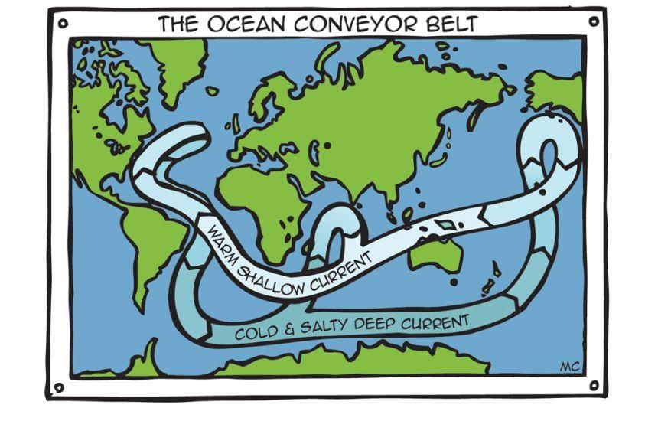
Ocean Currents
Notes:
The Ocean Converyor Belt is a deep underwater current that mixes the ocean’s water on a global scale. Warm surface waters move downwards, and cold nutrient-rich waters are forced up towards the surface. This process is very important as this upwelling of nutrients forms the basis of the food chain. If this is disrupted, it could threaten all ocean life.
Climate change can disrupt the ocean conveyor belt due to the melting of glaciers and land ice and increased rainfall in the North. This warm freshwater influx could block the formation of sea ice which in turn would prevent the sinking of cold salty water. If the converyor belt is slowed or even stopped in this way, Europe could see some drastic temperature changes, becoming much cooler and stormier.

Slide 11
What can I do?
Notes:
Emphasise that if we take action we can stop the harmful effects of climate change on the ocean. What actions can we take? - similar to Part one answers - stop using fossil fuels, reduce the amount of CO2 in atmosphere, walk or cycle instead of taking car. Don’t waste things- recycle, buy used instead of new, turn of lights. Plant trees. Eat less meat.

