Slide 1


Ocean and Carbon Literacy for Coastal Communities
How climate change is affecting our seas and what we can do about it.

Slide 2
Part three
The Ocean is a Climate Hero

Slide 3
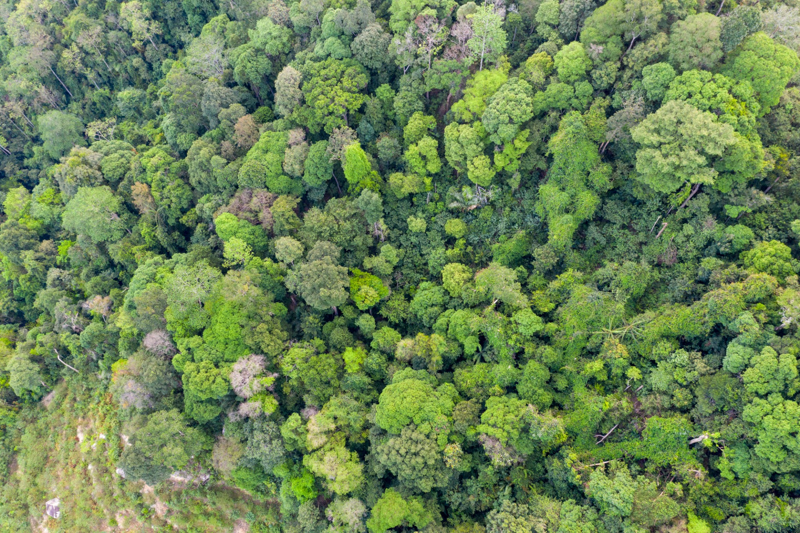
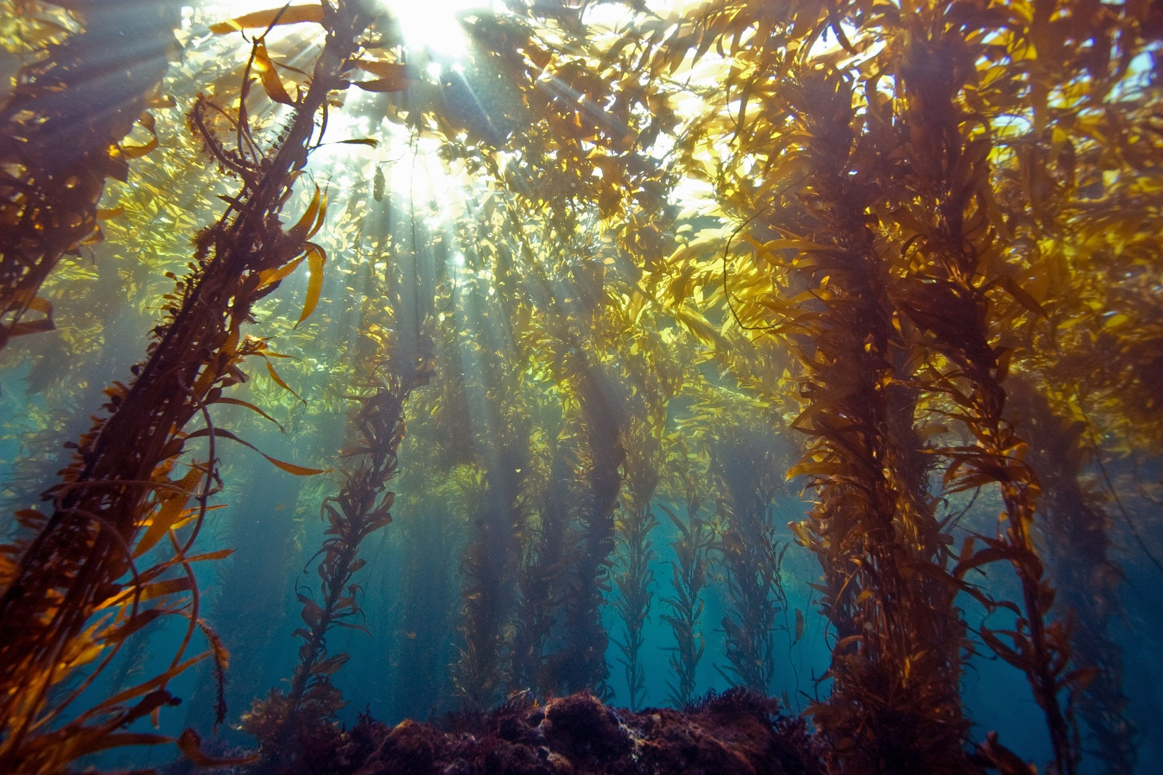
We need to keep the ocean healthy because it helps us fight climate change!
Take a breath Take another breath
50% of the oxygen we need is generated by the ocean but where does this oxygen come from?
Notes:
Oxygen comes from plants as it does on land. But in the sea these plants look a bit different. Seaweeds, seagrass, and tiny marine plants called phytoplankton all absorb carbon dioxide and produce oxygen through photosynthesis in the same way as trees and plants do on land.

Slide 4
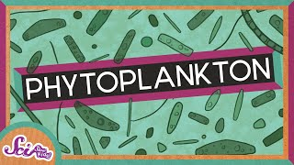
From the smallest……
PHYTOPLANKTON
.
Notes:
Phytoplankton is microscopic marine algae.
Some of the smallest phytoplankton are called Diatoms. Their cell walls are made of silica (like living in a glass house!) and they form beautiful and intricate patterns. The biggest diatoms are the width of a human hair. Scientists estimate that 20-30% of the oxygen we breathe is produced by diatoms.

Slide 5
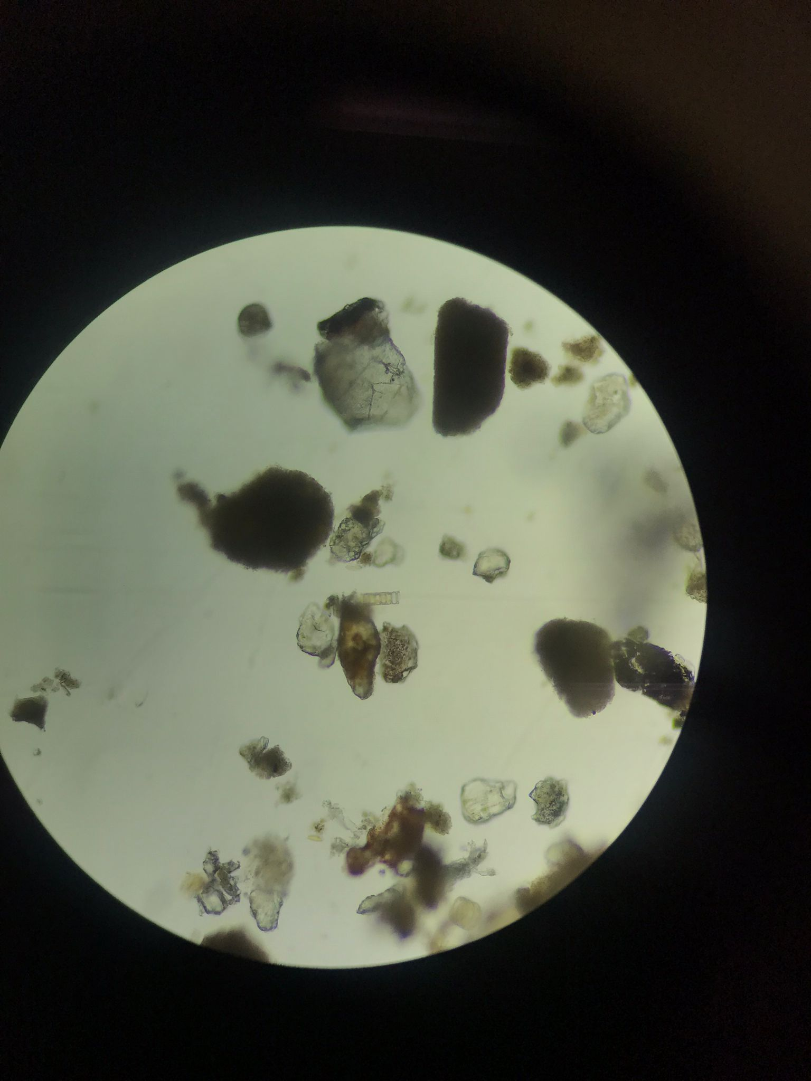
Notes:
Plankton seen under a microscope. In the centre of this image is a Chain diatom, found in water sample from St Abbs 25/10/2023
This water would seem empty to the naked eye, but once magnified is full of life!

Slide 6
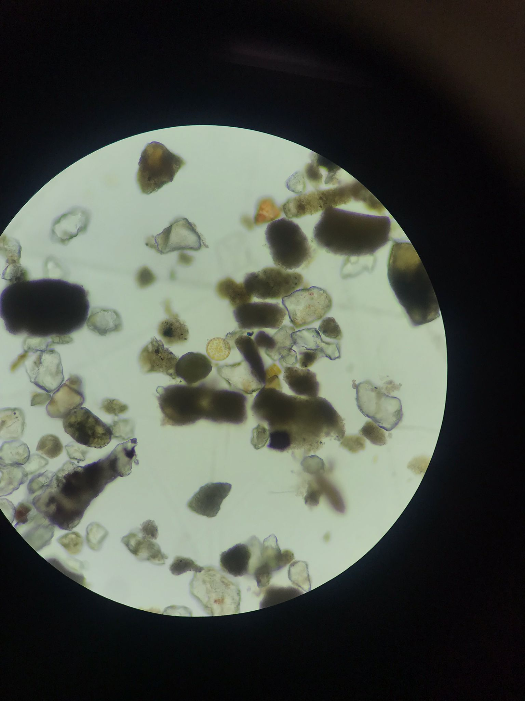
Notes:
Plankton seen under the microscope, in the centre is a Centric diatom found in water sample taken from St Abbs 25/10/2023

Slide 7
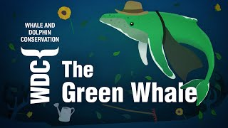
To the largest……
WHALES
The largest animals to have ever lived also help in the fight against climate change.
Notes:
The Blue Whale is the largest animal to have ever existed. This video shows how they also help in the fight against Climate Change. Whale poo is an important fertiliser for the phytoplankton that produces so much oxygen and is the start of the ocean food chain. And, when whales die, their bodies mostly sink to the ocean floor - locking in lots of carbon and stopping it from escaping into the atmosphere.

Slide 8
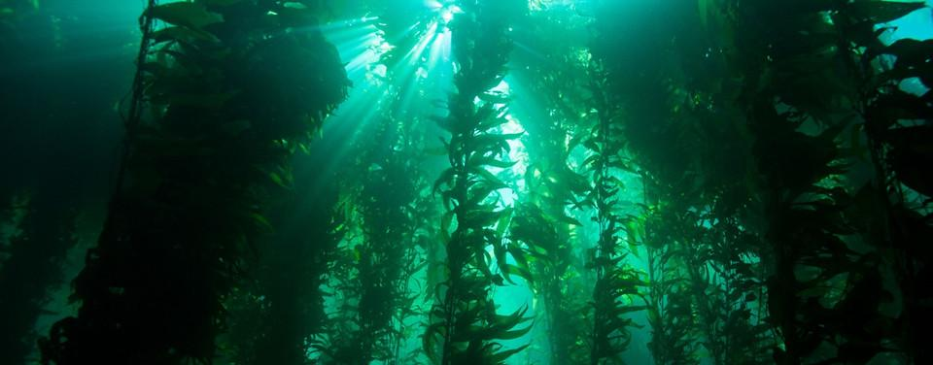
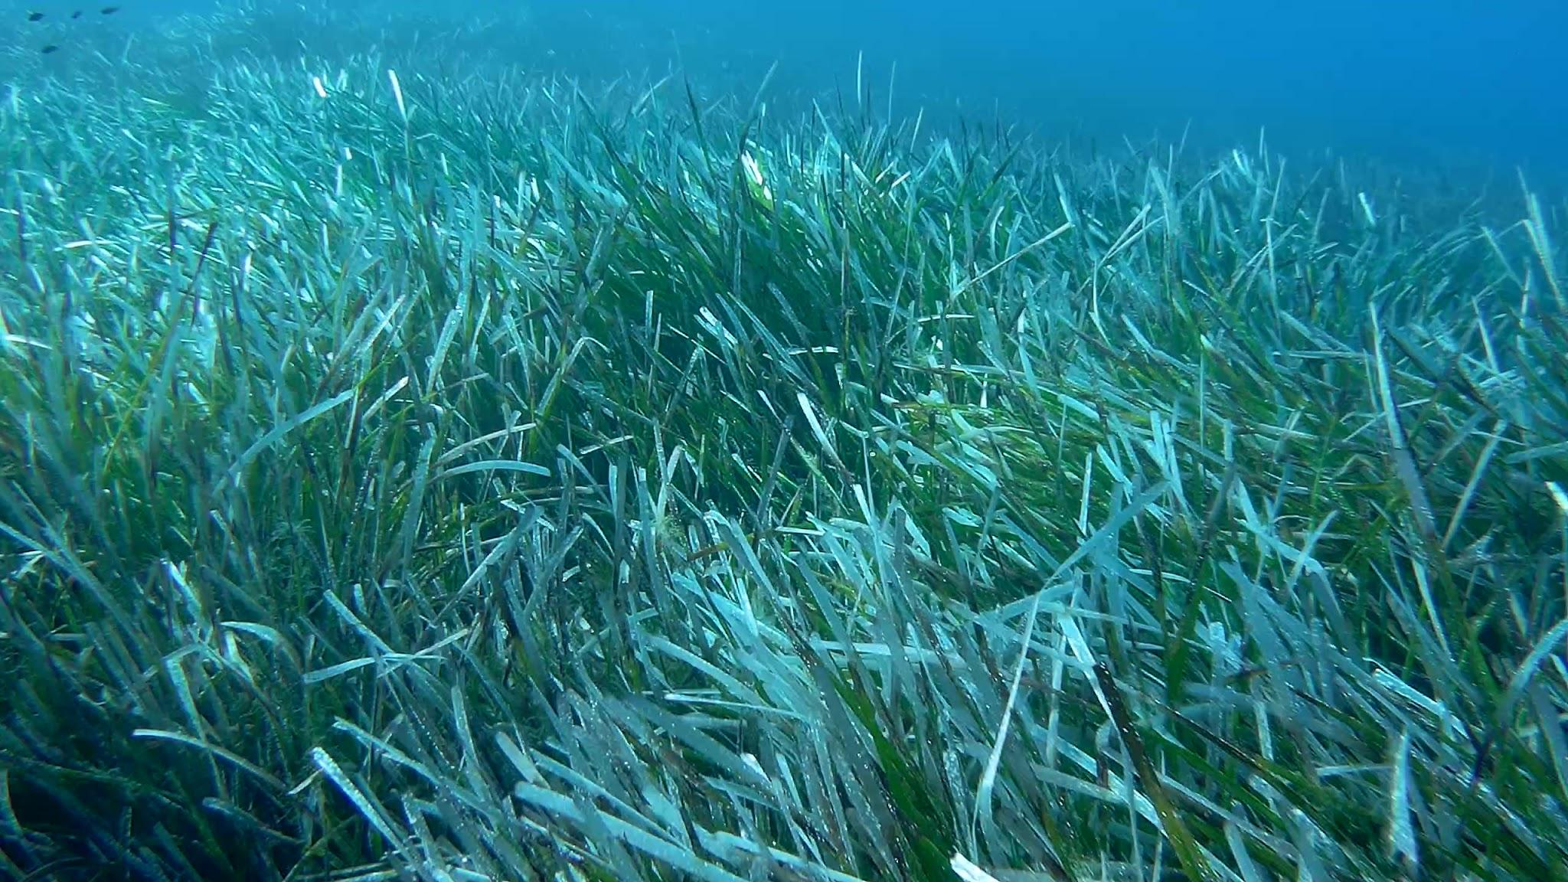
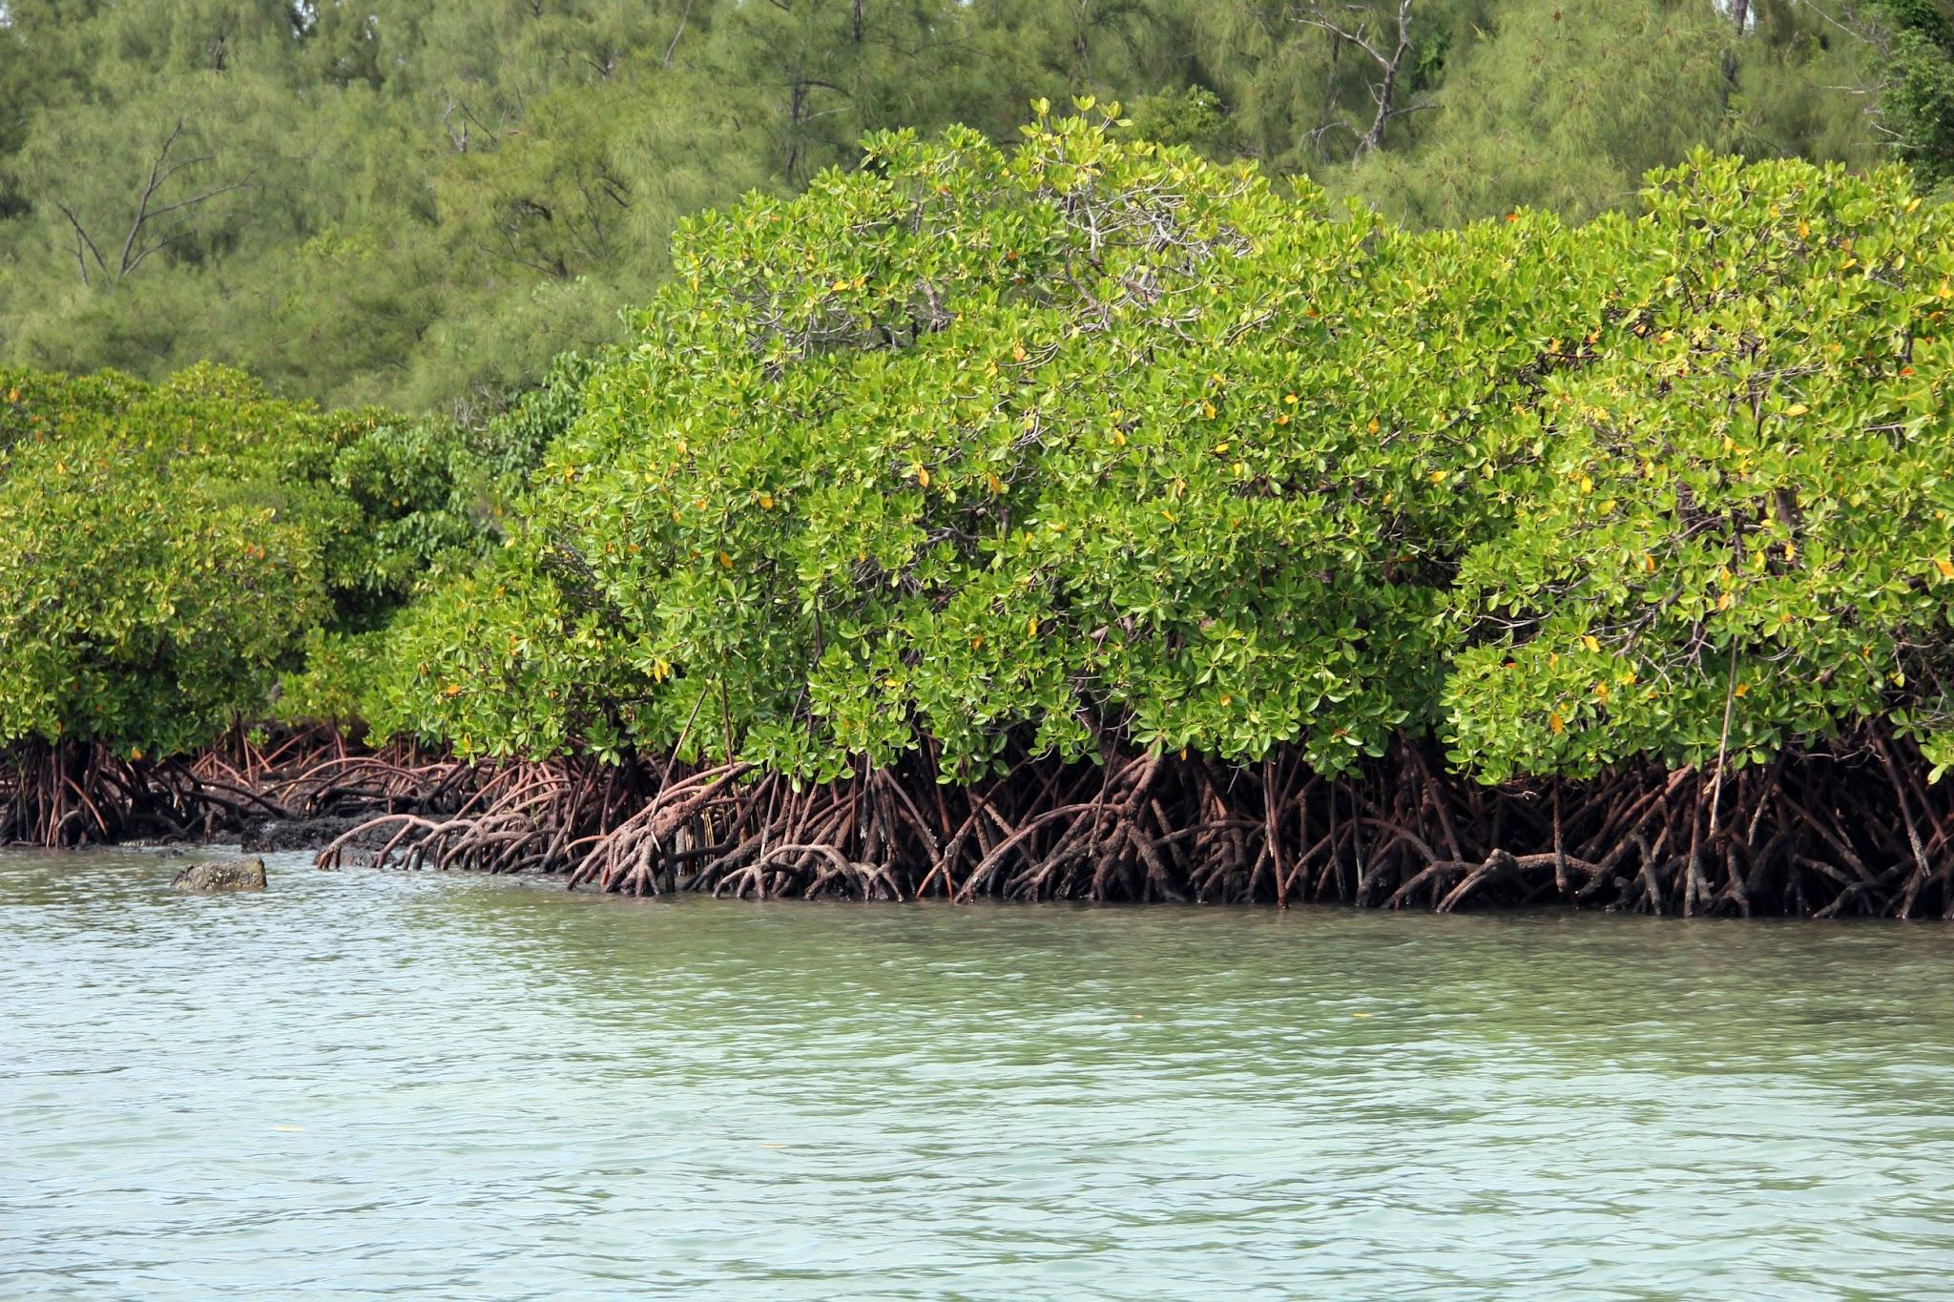
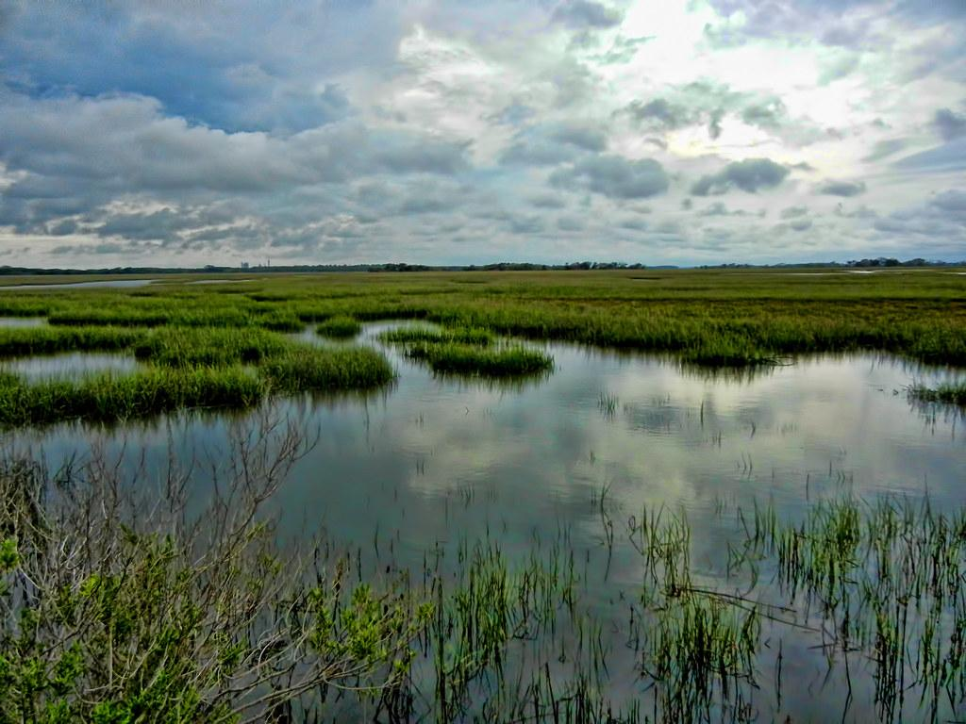
Forests of the Sea
Notes:
Kelp Forests, Seagrass, Mangroves and Salt Marshes

Slide 9
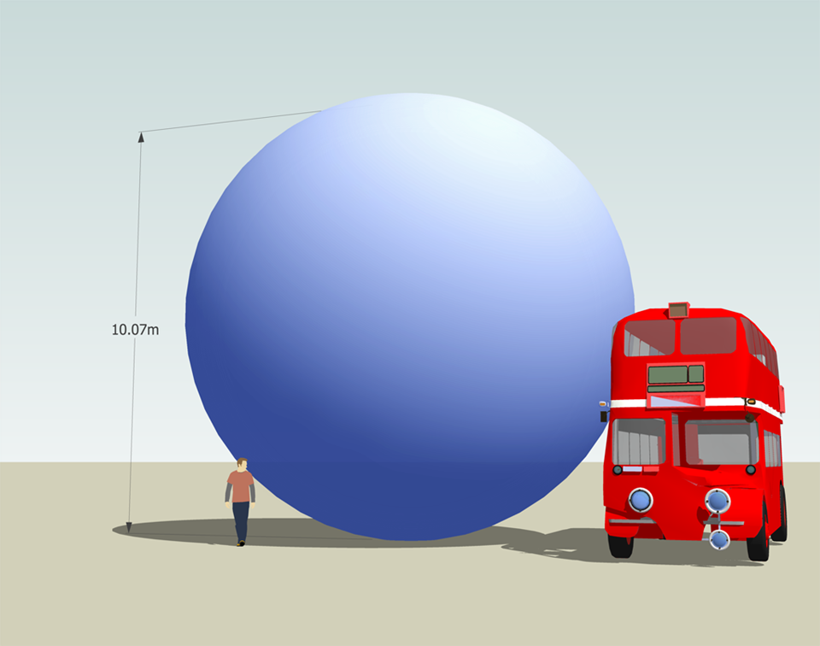
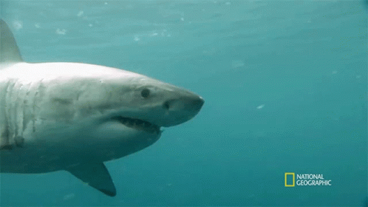
If we could see it - this is what one ton of Carbon Dioxide would look like!
One ton also happens to be how much a Great White Shark weighs!
Notes:
Kelp forests absorb around 4.5 million tons of CO2 every year
Per hectare, seagrasses can store up to twice as much carbon than forests on land. The worldwide seagrass ecosystem could store as much as 19.9 billion tons of carbon
It is estimated that the average annual carbon sequestration rate for salt marshes is between 6-8 tons of CO2 per hectare.
Mangroves store a similar amount of carbon as salt marshes do.

Slide 10
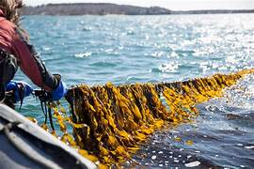
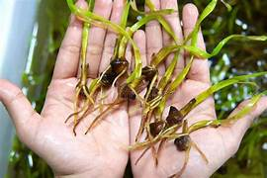
How can we protect them?
Restoration
Notes:
There are many different organisations throughout the UK and the world who are working to restore these valuable marine habitats. Seagrass can be restored by planting seeds and growing new meadows; Kelp forests can be restored, kelp can even be farmed - by being grown on ropes in the sea. Trawling has been banned in some areas to help preserve these important ecosystems.

Slide 11
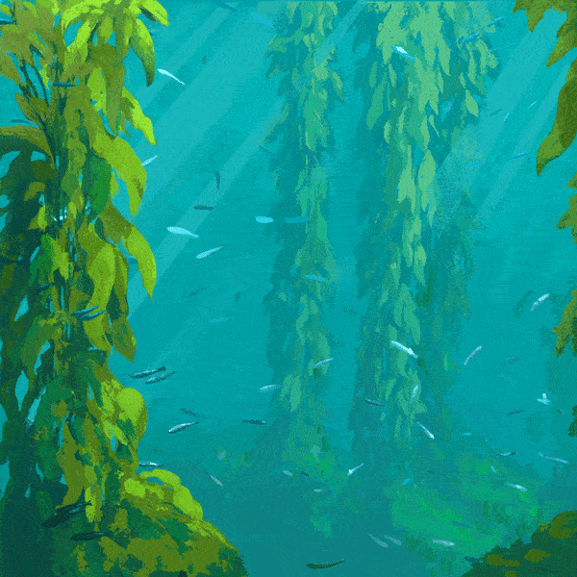
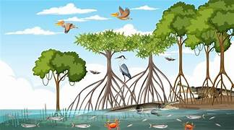
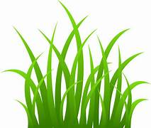
Nature’s Defences
Climate change is causing changes to our weather patterns, including stronger storms. The ocean can help to provide natural solutions to coastline defences.
How do you think they can help?
Notes:
All of these natural marine forests help to slow down and reduce wave power and storm surge, helping to prevent damage to coastal areas and coastal errosion.

Slide 12
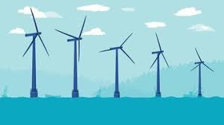
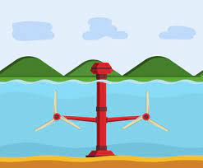
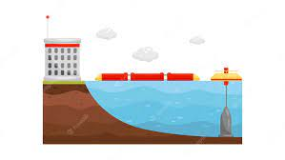

Renewable energy
Notes:
Offshore wind turbines, tidal power, wave power. Can you think of any nearby examples of this kind of energy creation? What are the benefits of this type of power. Are there any negatives? (think about impact on marine life - is it worth it on balance?)

